Slide 1

Bond Portfolio Management
Jean-Charles BERTRAND
Global CIO Multi Asset, HSBC Global Asset Management
Affiliate Professor at HEC
jean-charles.bertrand@hsbc.fr

Slide 2
Lectures
Basics of Bond markets and interest rate risk management
1. Money markets overview
2. Bond markets overview
3. Building Zero-coupon yield curves
4. Standard interest rate risk measures : duration and convexity
5. Beyond duration : Modern interest rate risk management
6. Active Fixed-income strategies
Fixed-income Asset Classes
7. Emerging Markets
8. Corporate Bonds and credit risk
9. Inflation-Linked Bonds

Slide 3
Grading
100% Final Exam
Open Book
Bonus for participation

Slide 4
1.Money markets
1.1 Monetary Policy
1.2 Money market rates
1.3 Money market instruments
1.4 Floating Rate Notes

Slide 5
1.1 Impact of monetary policy
Central Banks play a key role in money markets and bond markets
Central Banks’ intervention rate is the main tool of monetary policy
Monetary policy is conducted at the very shortest end of the yield curve
Examples ECB : Main Refinancing rate / Deposit Facility / Marginal Lending Facility
Fed : target Fed funds rate
Monetary policy has also a significant impact on the whole yield curve and ultimately affects the economy (transmission mechanism)

Slide 6
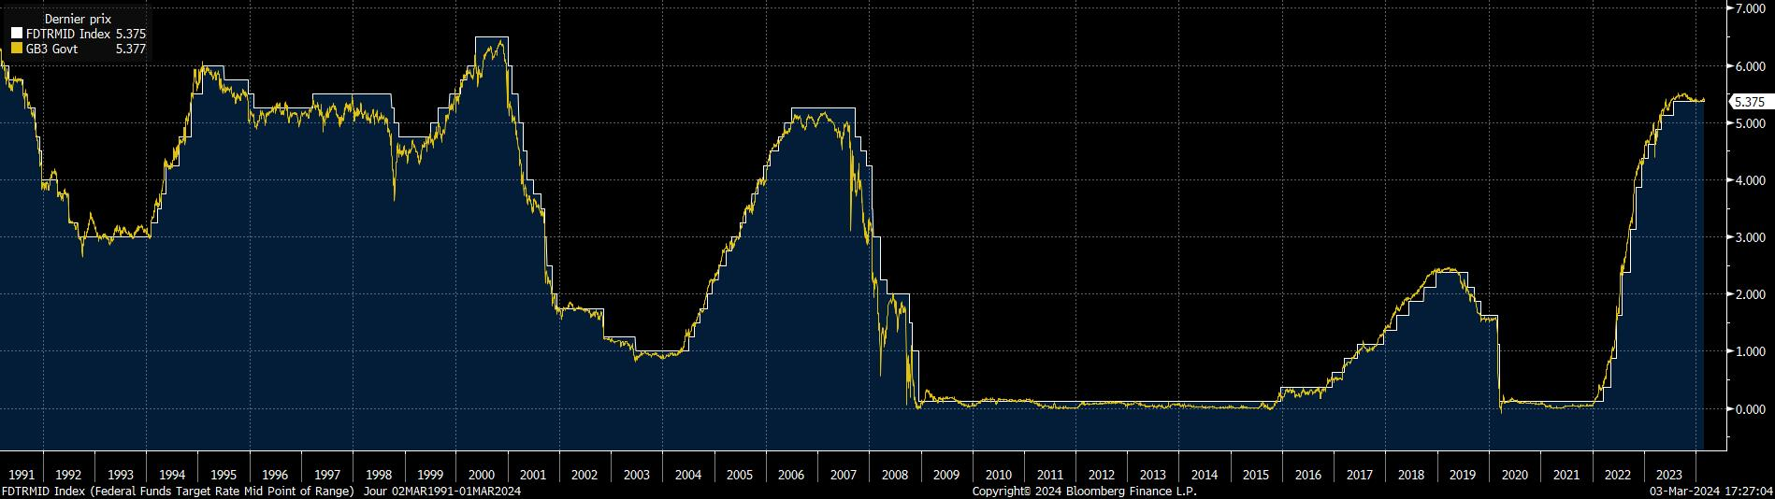

1.1 Monetary policy and money market rate

Slide 7
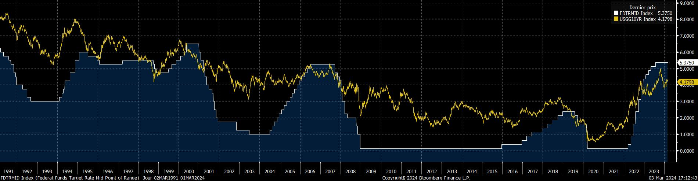
1.1 Monetary policy and long-term rate
Strong comovement of the Fed funds rate and the entire yield curv

Slide 8
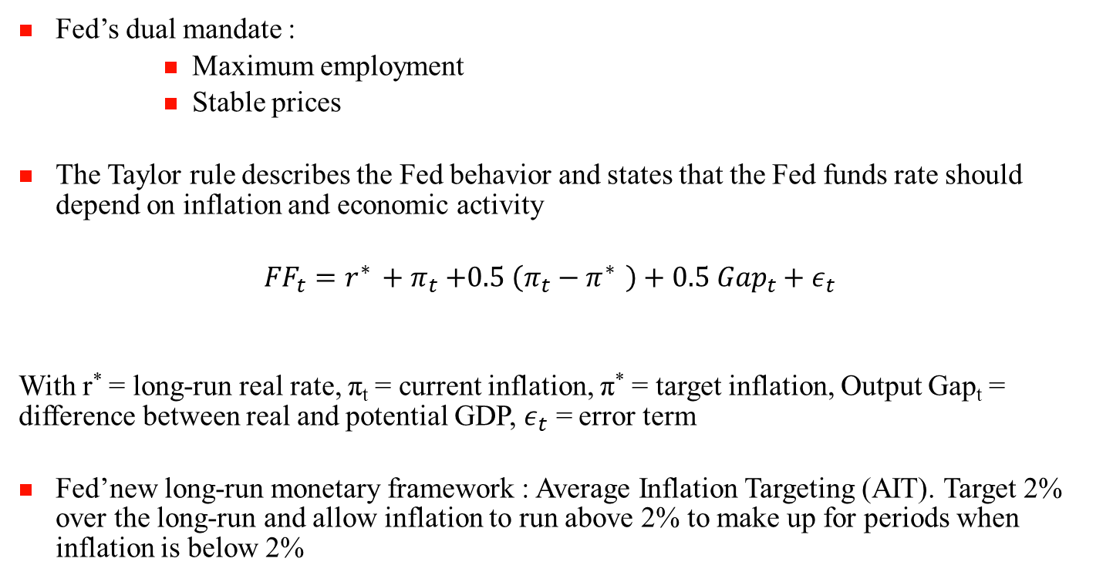
1.1 Monetary policy and the Taylor Rule
Fed’s dual mandate :
Maximum employment
Stable prices
The Taylor rule describes the Fed behavior and states that the Fed funds rate should depend on inflation and economic activity
$${FF}_{t}=r^{∗ }+π_{t}{+0.5 \left(π_{t}−π^{∗ }\right)+0.5 {Gap}_{t}+ε_{t}}^{}$$
With r* = long-run real rate, π_{t} = current inflation, π* = target inflation, Output Gap_{t} = difference between real and potential GDP, $ε_{t}$ = error term
Fed’new long-run monetary framework : Average Inflation Targeting (AIT). Target 2% over the long-run and allow inflation to run above 2% to make up for periods when inflation is below 2%

Slide 9
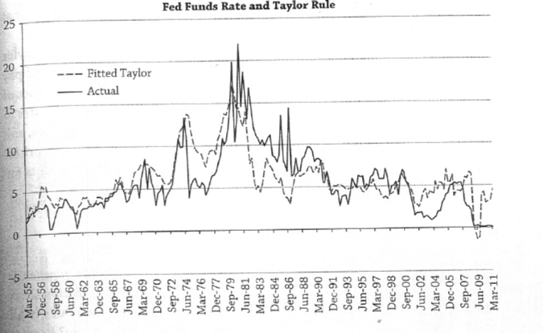
1.1 Monetary policy and the Taylor rule
Source : Ang, Asset Management

Slide 10
1.1 New Monetary policy
Quantitative easing :
If a recession continues even when Central Banks have lowered interest rate to nearly zero, Central Banks can no longer lower interest rates (liquidity trap)
Central Banks buy predetermined amounts of Government Bonds or other Financial assets to stimulate economy and increase liquidity
Strong increase of the size of the balance sheet of Central Banks
Stimulating the economy through different channels :
Credit channel
Portfolio rebalancing
Signal effect
ECB : LTRO and TLTRO
Term of 3 years
Increase collateral availability by relaxing rating theresholds
Stimulate Bank Lending

Slide 11
1.2 Which rates?
Rate on a discount basis / Rate on a money-market basis
Discount basis:
with X = value at maturity
Money market basis:
How to compare?

Slide 12
1.2 Reference rates
T bill rates
From EONIA ( Euro OverNight Interest Average) to ESTR (Euro Short-Term Rate)
From IBOR (Average of « offer » rates for various maturities (1 mth, 3 mth…)) to alternative reference rates :
Switch from quotation-based to transaction-based rates
Overnight rates
Involvement of Central Banks in the calculation
IBOR rates will be replaced by new reference rates in 2023 with the exception of revised Euribor
SOFR

Slide 13
1.3 Money market instruments
Issuer
Securities
Characteristics
T Bills
Maturity < 1 year
Govt
Discount basis
Short-term Bonds
Maturity between 2 and 5 years
Corporate
Commercial papers
Maturity < 1 year
Money market basis
Financial Institutions
Certificates of deposit
Maturity <1 year
Specific case : Floating Rate Note

Slide 14
1.3 Derivatives on forward rates
Future Rate Agreement (FRA)
Objective : Locking at t=0 a borrowing rate R from T₁ to T₂
R is the forward rate = F(0,T₁,T₂) !
The forward rate is given by
(1+y(0,T₂))^{T2} = (1+y(0,T₁))^{T1} (1+F(0,T₁,T₂))^{T2-T1}

Slide 15
1.3 Derivatives on forward rates
 | FRA | Borrowing
t=0
t=T₁ |  | +100
t=T₂ | +100(y(T₁,T₂)-R)*(T₂-T₁)/360 | -100 (1+y(T₁,T₂)*(T₂-T₁)/360
FRA flows are paid at T₁ and have to be discounted !

Slide 16
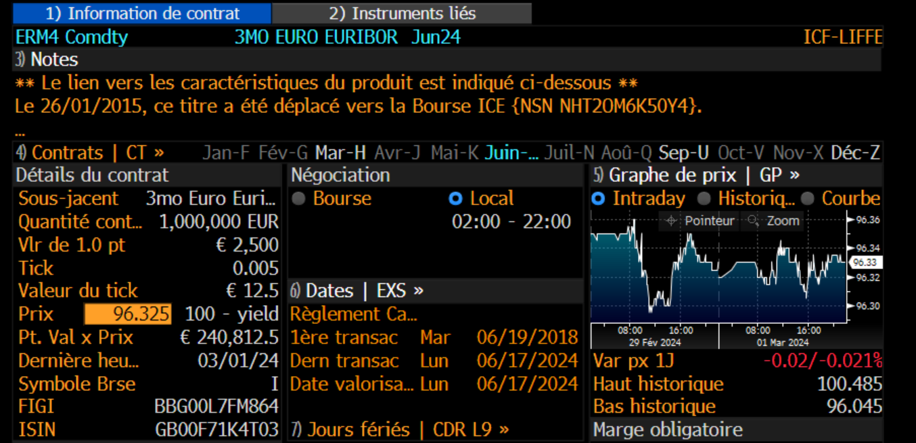
1.3 Derivatives on forward rates
Short-term rate Futures : standardized FRA

Slide 17
1.4 Floating-rate notes
Bond securities that bear floating rate coupon rates
Coupons are indexed on :
Money market rates (Eonia, Libor…) – Floating rate Bonds
Bond market rates (CMT) - Variable-rate bonds or adjustable-rate bonds

Slide 18
1.4 Types of indexation
Coupon formula :
C(t) = α I(t-h) + β
with α : multiplicative margin
β : additive margin
h : lag between rate observation date and payment date
Example :
C(t) = 3 mth Libor (t-3 mth) – 0.15%

Slide 19
1.4 Analysis of Floating-Rate Bonds (FRB)
Equivalent to a strategy of short-term loans rollover
Choice between 2 strategies :
Buy a FRB with a coupon payment frequency equal to the frequency rate. Additive and multiplicative rates are respectively equal to 0 and 1
Loan rollover at I(t)

Slide 20
1.4 Analysis of FRB
Loan rollover
The flows are equivalent to a FRB !
t=0 | t=1 | t=2 | … | t=T
-100 | +100(1+I(0)) | +100(1+I(1)) |  | +100(1+I(T-1))
 | -100 | -100

Slide 21
1.4 Analysis of FRB
The price is equal to par at each payment date
Price at t between t_{n} and t_{n+1} (coupon payment dates)
A FRN is equivalent to a ZC bond with maturity ((t_{n+1})-t) / 365 and principal equal to 100+C(t_{n+1})
Low interest-rate risk but significant credit risk (margin change)

Slide 22
1.4 Analysis of Variable Rate Bonds
Example : Constant Maturity Treasury (CMT) Bond
The floating coupon is indexed on 10-year CMT reference
10-year CMT is interpolated between 2 Treasuries bond yields with maturities close to 10 years
The pricing and analysis of variable rate bonds is challenging and requires term structure models
Generally, investors in variable rate bonds are hedged against parallel shifts of the yield curve

Slide 23
2.Bond markets
2.1 Overview of bond markets
2.2 Types of interest rates
2.3 Term structure empirical properties
2.4 Classic Term structure theories
2.5 Bond quotation and Yield to Maturity

Slide 24
2.1 Bonds
Definition : loan negotiated on a secondary market
Characteristics :
Issuer
Nominal
Coupon
Maturity
Currency
Seniority
Usually Fixed-rate and in Fine (redemption value equal to 100% of nominal)

Slide 25
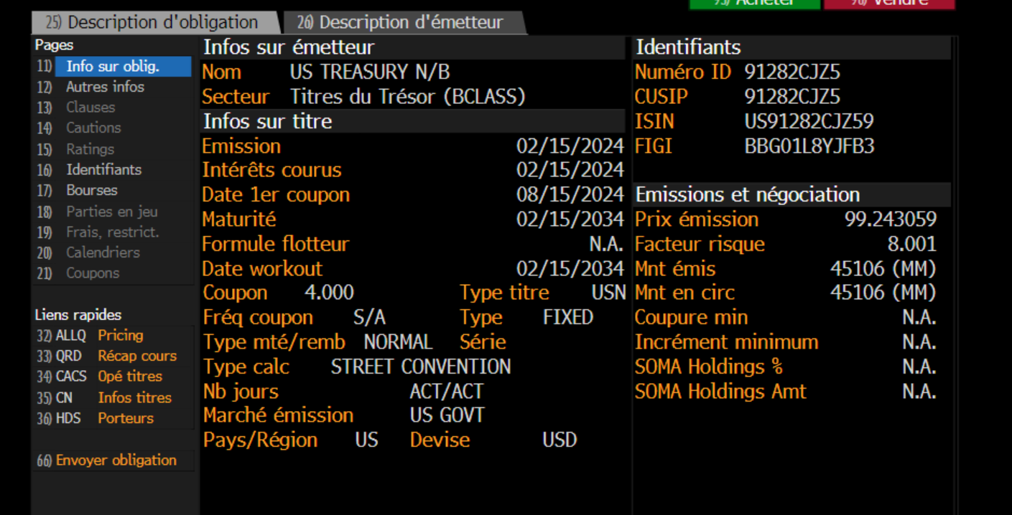
2.1 Bonds

Slide 26
2.1 Bond Markets
Markets
Primary / Secondary
Domestic / Euro / International
Market Makers
Instruments
Plain vanilla bond : Fixed Coupon, redemption value equal to principal amount
Non plain-vanilla : floating coupon, options…
Government / Corporate (Investment Grade, Speculative Grade)

Slide 27
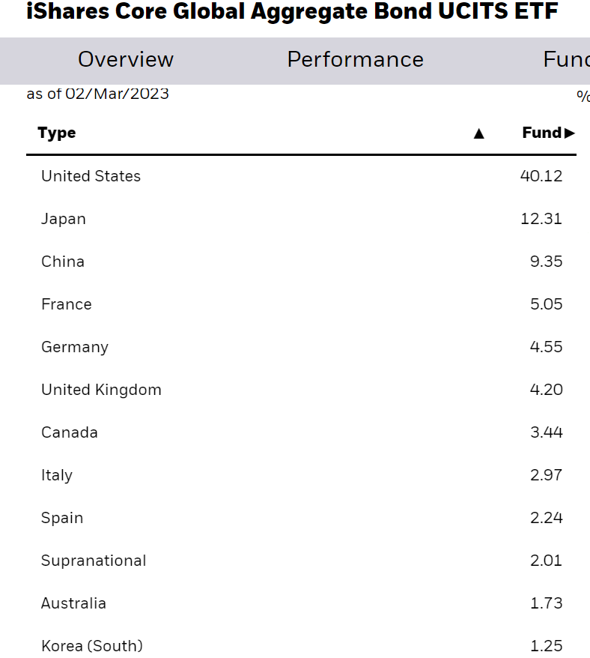
2.1 Overview of bond markets : Bloomberg Barclays Global Aggregate

Slide 28
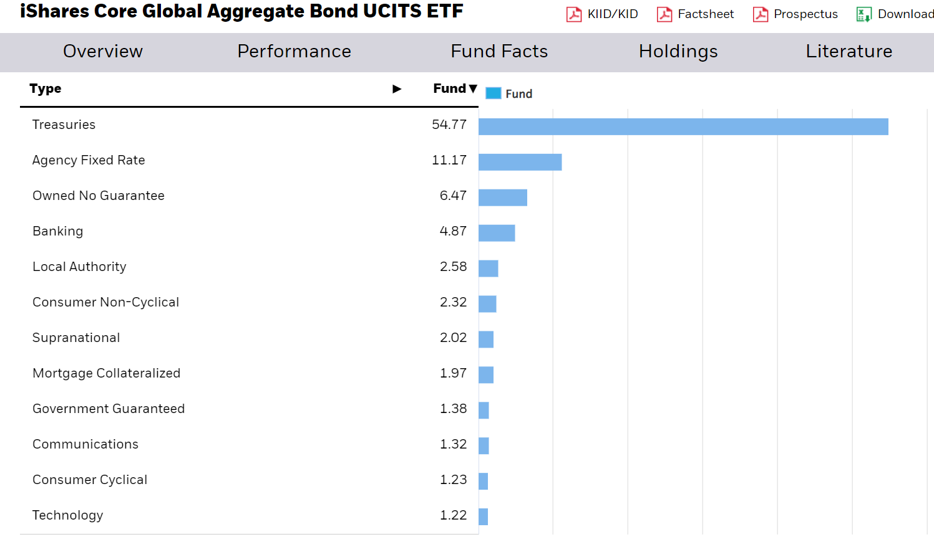
2.1 Overview of bond markets : Bloomberg Barclays Global Aggregate

Slide 29
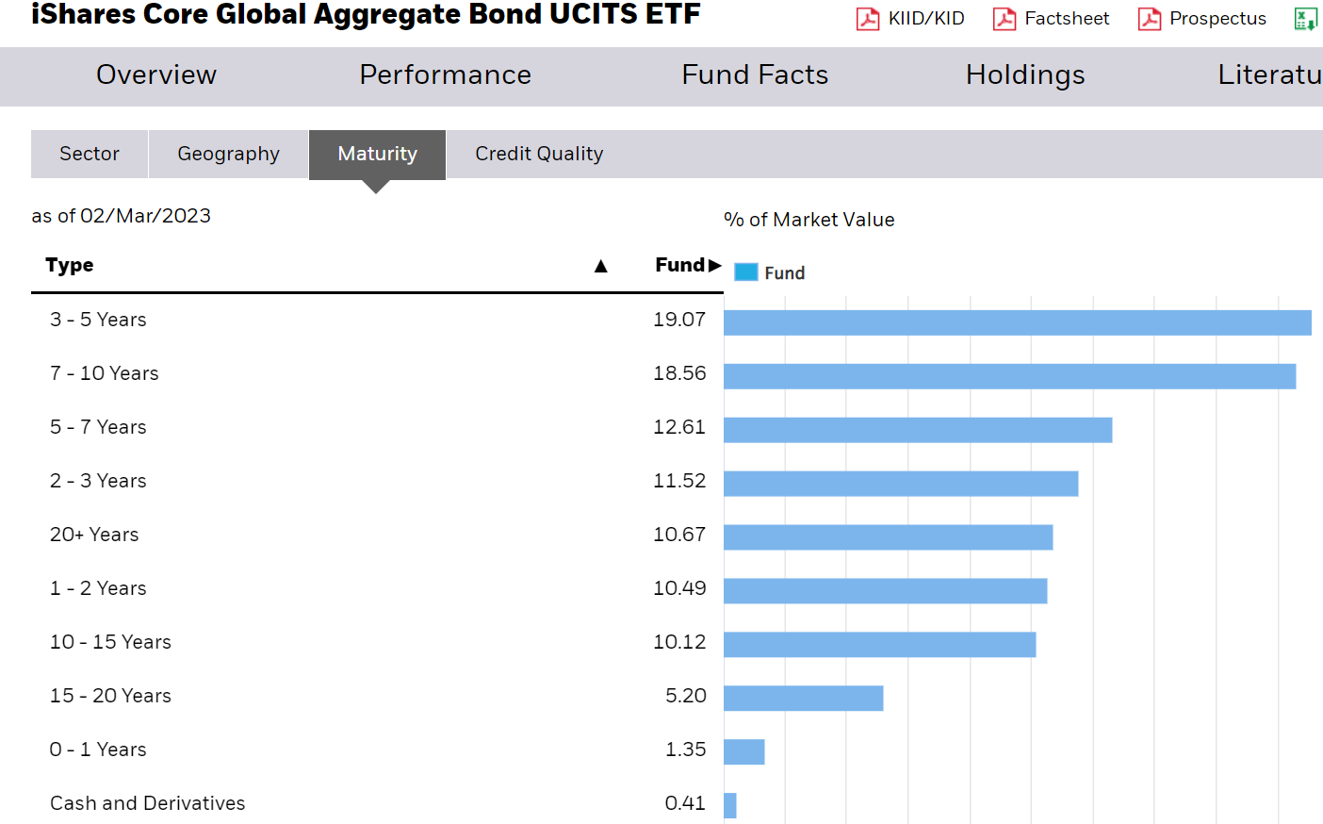
2.1 Overview of bond markets : Bloomberg Barclays Global Aggregate

Slide 30
2.2 Interest rates types
Yield to Maturity
Spot zero-coupon rate
Forward rate
Swap rate

Slide 31
2.2 Interest rates types
Yield to Maturity (r )
It is specific to a given bond
Rate that sets the present value of the cash flows equal to bond price
One to one correspondence between the market price and the YTM

Slide 32
2.2 Interest rates types
Spot Zero-coupon or discount rate ( y(0,i) )
It is specific to a given maturity
It is defined by
Quite often, such an instrument does not exit and zero-coupon yield curves have to be derived from Coupon Bond prices

Slide 33
2.2 Interest rates types
Forward rates ( F(0,T₁,T₂) )
The implied forward rate between T₁ and T₂ is given by
It is the rate that can be guaranteed now for a loan starting at date T₁ and repayable at date T₂

Slide 34
2.2 Interest rates types
Swap rates : fixed rate of a floating rate (6 mth Euribor) against Fixed rate of an IRS
Swap rate : market quotation
Swap Value = Fixed rate Bond – Floating rate Bond
The swap value is null at inception

Slide 35
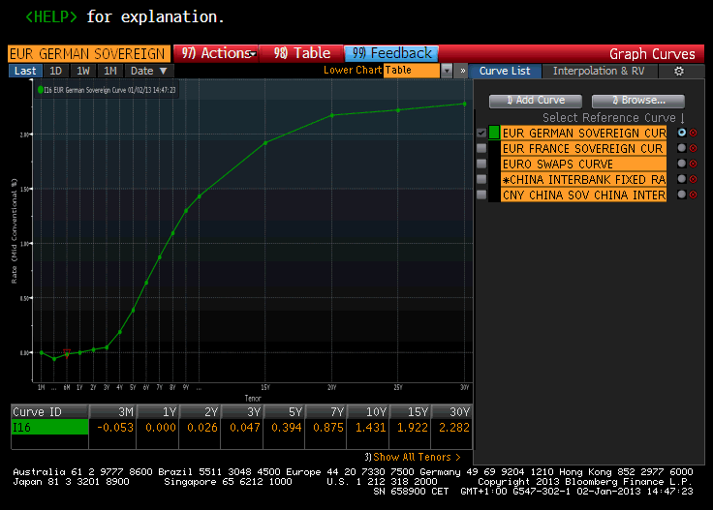
2.3 Interest rate Term structure : empirical properties
The term structure can take several shapes : increasing, decreasing, humped

Slide 36
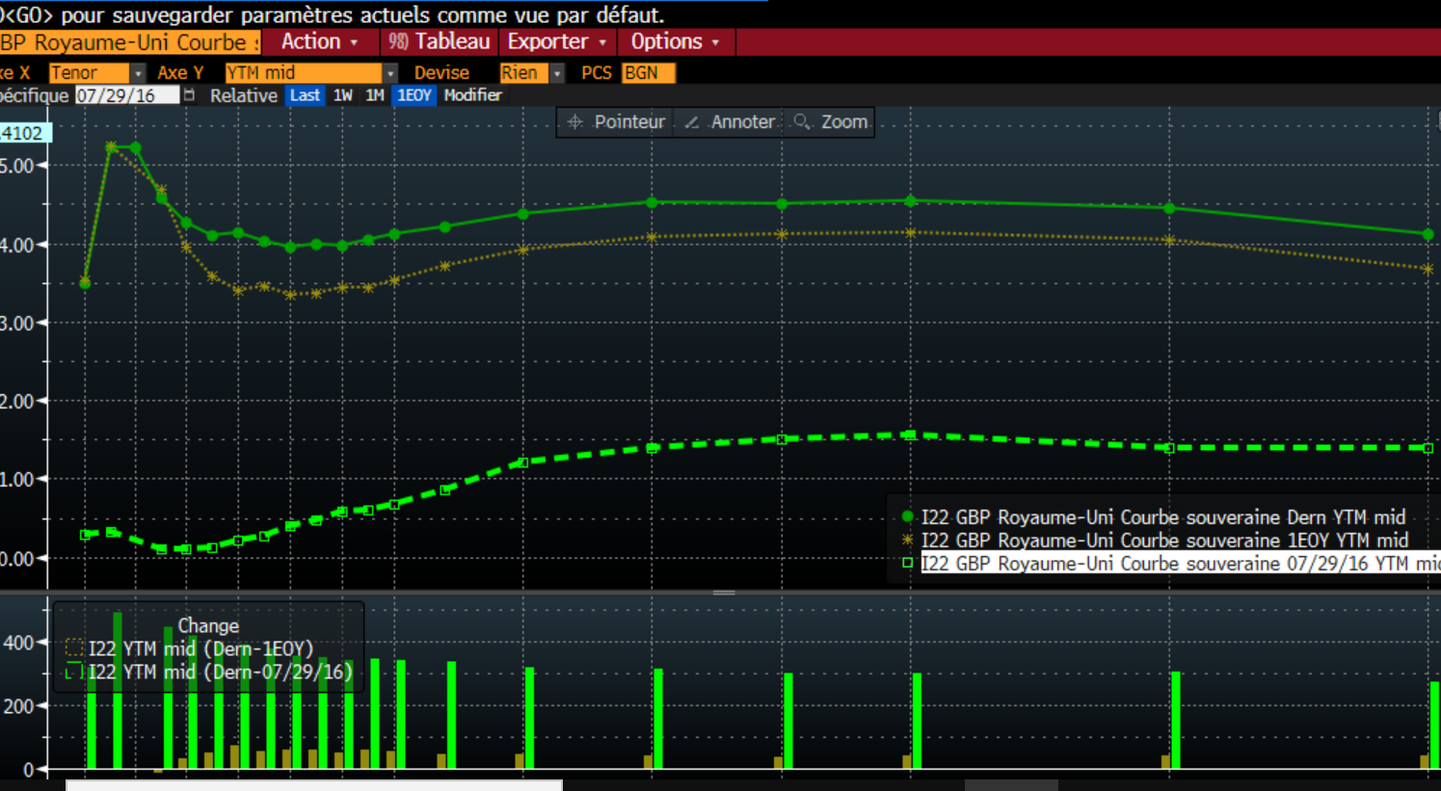
2.3 Interest rate Term structure : empirical properties

Slide 37
2.3 Interest rate Term structure : empirical properties
Interest rates are not negative (in normal times…)
Mean reversion

Slide 38
2.3 Interest rate Term structure : empirical properties
Changes in interest rates are significantly but not perfectly correlated

Slide 39
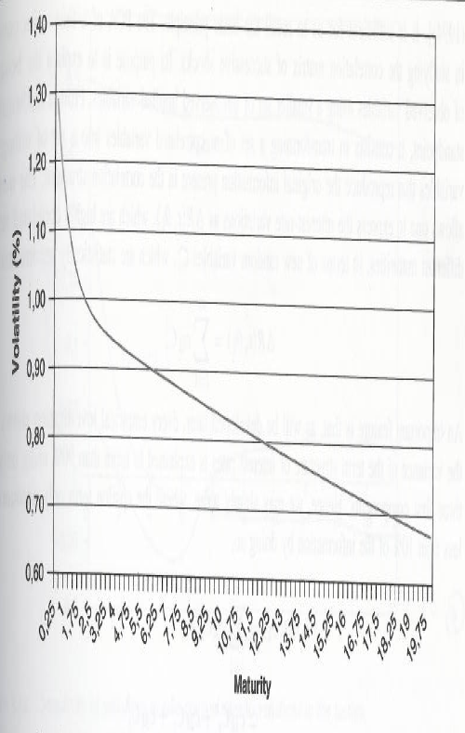
2.3 Interest rate Term structure : empirical properties
We consider the standard deviation of absolute changes in interest rates : σ(Δr)
Short term rates are more volatile than long-term rates

Slide 40
2.4 Classic Term structure theories
Pure Expectations Hypothesis (PEH)
Liquidity (or Risk or Term) premium theory
Preferred habitat hypothesis

Slide 41
2.4 Pure expectations Hypothesis
Yield difference across maturities only reflect the market’s rate expectations
Upward sloping yield curve :
Investors anticipate increases in interest rates
Any Long-term bond’s yield advantage exactly offset expected capital loss
All government bonds have the same near-term expected return !

Slide 42
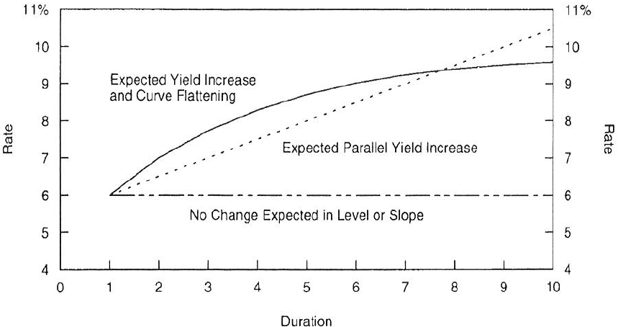
2.4 Pure Expectations Hypothesis
Source : Ilmanen , Understanding the yield curve
The expected return of holding a long bond until maturity is the same as the expected return from rolling over a series of short-term bonds
Forward rate = Expectations of future short-term rate

Slide 43
2.4 Liquidity Premium Hypothesis
The PEH ignores interest rate risk :
Except if calculated until maturity, the return on a bond is uncertain and investors may require compensation
Most investors dislike short-term fluctuations in asset prices
Long-Term bonds offer a positive risk premium
E(future short rate) = forward rate – Risk premium

Slide 44
2.4 How putting PEH and LPH together ?
Market’s expectations and bond risk premia are not directly obervable !
The two components must be estimated but it is difficult to disentangle them
Steep yield curve = market’s expectations of rising rates or high required risk premia ?
Empirical evidence seems to reject PEH
Steep yield curves tend to be followed by abnormally high returns
Forward rates systematically exceed rates expectations provided by surveys
Combining PEH and LPH :
Long-term Yields = Average of expected short-term rates + Risk premium

Slide 45
2.4 Preferred Habitat Hypothesis
It is based on market segmentation
Different investor categories investing on a given curve segment (corporates vs pension funds/insurance)
Curve shape determined by the law of supply and demand

Slide 46
2.5 Bond valuation and quotation
Relationship between the price of a bond P (dirty or gross price) delivering coupons annually (and semiannually) and Yield to maturity r :
C : Coupon rate
t= Days since last coupon payment / Days in coupon period
Accrued Interest = C *100 * t ( C/2 *100 *t)
P $=\sum_{i=1}^{2T}{\frac{F_{i}}{{(1+r/2)}^{i−t}}}={(1+r/2)}^{t} (\sum_{i=1}^{2T}{\frac{C/2}{{(1+{r/2}_{})}^{i}}}+\frac{100}{{(1+r/2)}^{2T}}$ )

Slide 47
2.5 Accrued Interest - Conventions
Accrued Interest = C x Day count since last coupon payment
Day-count type conventions:
European market : Actual / Actual, annual frequency
UK market : Actual / Actual , semi annual frequency
US market : actual / actual , semi annual frequency
Act/365, Act/360…

Slide 48
2.5 Bond valuation and quotation
Definition of the clean price :
Clean price = Gross price – Accrued Interest
Only the clean price is quoted

Slide 49
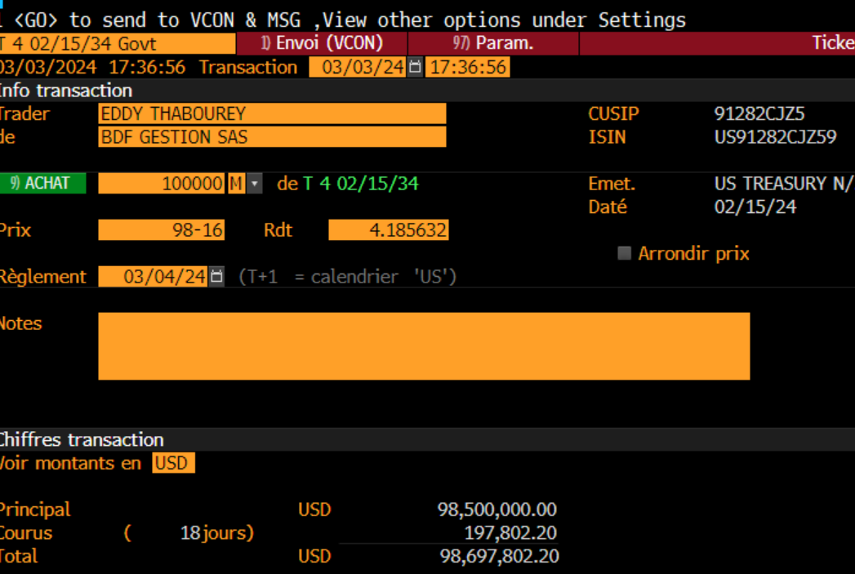
2.5 Bond valuation and quotation

Slide 50
2.5 Impact of Yield to Maturity on Price
Inverse relationship between price and yield to maturity
P (r) is a convex function

Slide 51
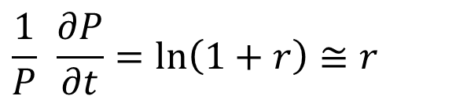
2.5 Impact of time on bond return
P = f (t, r)
We want to estimate the impact of the passage of time on bond price and return
We have to calculate the partial derivative of bond price with respect to time (keeping r constant)
$$\frac{1}{P} \frac{∂P}{∂t}=\ln\left(1+r\right)≅r$$

Slide 52
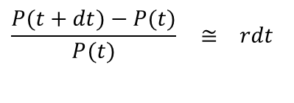
2.5 Impact of time on bond return
The gain of the passage of time is the YTM and not the coupon rate !
= coupon rate + convergence to par
We use a Taylor series expansion to determine the bond return between t and t+dt
$$\frac{P(t+dt)−P(t)}{P(t)} ≅ rdt$$

Slide 53
2.5 YTM is not always relevant…
Implicit assumptions :
Flat term structure
Coupons are reinvested at r

Slide 54
2.5 YTM is not always relevant…
YTM is not necessarily equivalent to the rate of return even for a buy and hold investor
The total rate of return is unkown at inception as coupons have to be reinvested at an unkown rate

Slide 55
2.5 YTM is not always relevant…
Identical flows can be discounted at different rates
YTM is not a Rate of return in most cases

Slide 56
2.5 YTM is not always relevant…
Reinvestment risk
Example:
5-year maturity
YTM at purchase = 9%
Future coupons are reinvested at 7%
Coupon | Purchase price | 5-year Value | Total rate of return
7% | 92.22 | 140.26 | 8.75
9% | 100 | 151.76 | 8.70
11% | 107.78 | 163.26 | 8.66

Slide 57
2.5 YTM is not always relevant…
Future coupons are reinvested at 9%
Conclusion:
YTM is equivalent to the total rate of return only if future coupons can be reinvested at YTM
Coupon | Purchase price | 5-year value | Total rate of return
7% | 92.22 | 141.89 | 9%
9% | 100 | 153.86 | 9%
11% | 107.78 | 175.83 | 9%

Slide 58
2.5 YTM is not always relevant…
YTM is mainly a convenient way of reexpressing the bond price
ZC rates are the relevant discount rates

Slide 59
3. Zero-Coupon curves
3.1 Definition of zero-coupon rates
3.2Building Zero-coupon curves : bootstrapping methodology
3.3 Building zero-coupon curves : Vasicek-Fong methodology
3.4 Properties of zero-coupon curves

Slide 60
3.1 Zero coupon rates
A zero-coupon rate is specific to a given maturity
Zero-coupon rates can be derived directly from Zero-coupon bonds (strips)
Relationship between price and zero-coupon rate:
Zero-coupon bonds do not always exist
Zero-coupon bonds do not cover all maturities
.

Slide 61
3.1 Zero coupon rates
Construction of zero-coupon rates based on the market price of coupon-bearing bonds
Coupon-bearing Bond = Portfolio of Zero-Coupon Bonds
Bootstrapping or indirect methods

Slide 62
3.1 How to build zero-coupon yield curve ?
Principle:
The zero-coupon yield curve has to be consistent with existing coupon-bearing bond prices. We need to select a basket of bonds
Bootstrapping:
Recursive procedure
Basket of par bonds
Closed-form formula
Indirect methods
Fitting the data to a prespecified form of the zero-coupon yield curve
Example: Vasicek-Fong

Slide 63
3.2 Bootstrapping
Principle:
r_{i}: YTM of a par bond with maturity i
y(0,i): ZC rate with maturity i
Par bond ( C= r_{T}) :
with i = 1,….T
1-year zero-coupon : y(0,1) = r₁
2-year zero-coupon :

Slide 64
3.2 Bootstrapping
Closed-form formula:
Simple and intuitive
Limits:
Repetitive procedure
Par bond basket (mainly used to derive zero-coupon swap rates)

Slide 65
3.3 Vasicek-Fong methodology
Principle:
We postulate an exponential polynomial form (degree p) for the discount factor of maturity i
b_{j} parameters are estimated by minimizing the sum of squared residuals.
Market price of bond k = theoritical price + Residual = Bond Price based on Z-C rates + Residual
Let’s consider bond k with a coupon rate C and maturity T_{k;}

Slide 66
3.3 Vasicek-Fong methodology
Principle: Let’s use the prepecifided function for the discount factors and rearrange the terms
Assumption for the value of α
We have to estimate the bj parameters

Slide 67
3.3 Vasicek-Fong methodology
Let ‘s consider a basket of n coupon bonds
Optimisation program :
Limits:
Basket choice
Choice of p

Slide 68
3.4 Zero-coupon curves
Comparaison between bootstrapping and Vasicek-Fong methods
8,00%
7,00%
6,00%
5,00%
4,00%
3,00%
2,00%
Vasicek Fong
1,00%
Bootstrapping
0,00%
0
5
10
15
20
25
30
35
Maturity

Slide 69
3.4 Zero-coupon curves
Comparison between YTM and ZC curves
3.8%
3.3%
2.8%
2.3%
YTM rates
ZC rates
1.8%
0
5
10
15
20
Maturity

Slide 70
3.4 Zero-coupon curves
ZC yield curves are steeper than YTM curves
Changes in ZC rates are very similar to changes in YTM rates

Slide 71
3.4 Zero-coupon curves and Rich/cheap analysis
Coupon Bonds ZC rates
(market price)
Coupon Bonds
(theoritical prices)
Rich / Cheap analysis
Take into account estimation error

Slide 72
4. Standard interest-rate risk measures
4.1 Duration and Modified Duration
4.2 Convexity
4.3 Barbell-Bullet strategy

Slide 73
4.1 Measures of interest rate risk
Duration, $ Duration and Modified Duration :
$ Duration = Mod Duration * P

Slide 74
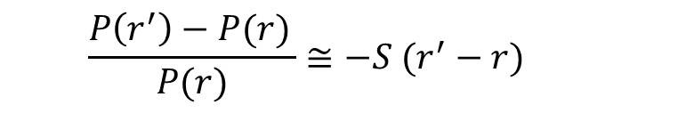
4.1 Measures of interest rate risk
DV01 measures the price change for a 1 bp rate change
Impact of a rate change from r to r’on bond return (One-Order Taylor expansion):
$$\frac{P\left(r^{′}\right)−P(r) }{P(r)}≅−S (r^{′}−r)$$

Slide 75
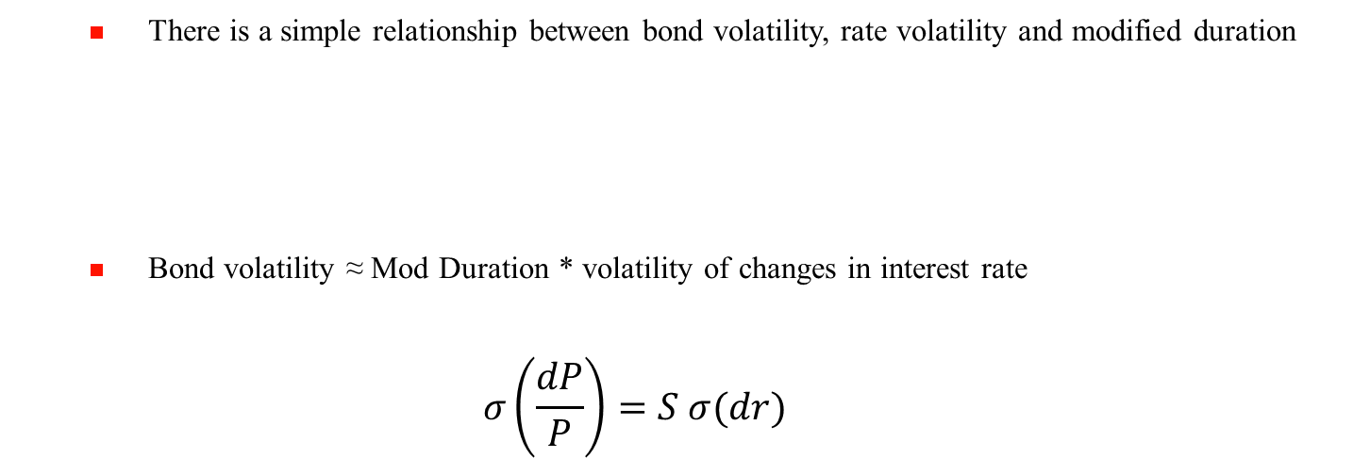
4.1 Bond volatility
There is a simple relationship between bond volatility, rate volatility and modified duration
Bond volatility ≈ Mod Duration * volatility of changes in interest rate
$$σ\left(\frac{dP}{P}\right)=S σ(dr)$$

Slide 76
4.1 Modified Duration of a portfolio
Definition: Weighted average of individual modified durations
Implied assumption : rate changes are identical for any maturity ( shift)

Slide 77
4.1 Properties of duration (modified duration)
Maturity
Coupon rate
YTM

Slide 78
4.1 Limits of Modified Duration as an interest rate risk measure
Approximation if rate changes are not infinitesimal
Convexity
Implicit assumption of a shift of the yield curve:
Take into account the changes for all maturities
.

Slide 79
4.2 Convexity
Taking into account the fact there is a non linear relationship between Price and Yield
2nd order Taylor expansion :

Slide 80
4.2 Convexity
120.00
Bond Price
115.00
Approximation
110.00
105.00
100.00
95.00
90.00
85.00
80.00
2.0
2.5
3.0
3.5
4.0
4.5
5.0
5.5
6.0

Slide 81
4.2 Convexity
Convexity is always « favourable » for a classical fixed-income bond
Convexity is homogeneous to (Duration)²
But there is no free lunch…
Investors have to pay higher prices for bonds with greater convexity
Convexity bias
Impact on the shape of the yield curve (humped curve)

Slide 82
4.2 Convexity of callable bonds
Bond issuer has an option to call back the bond at strike price and not market price.
Biggest market : Mortgage Backed Securities
Convexity can be negative

Slide 83
4.2 Convexity of callable bonds
When interest rates are high, the curve is convex. As interest rates fall, there is a ceiling in the possible price (call price = strike of the call option)
Negative convexity

Slide 84
4.3 Barbell-bullet strategy

Slide 85
4.3 Barbell-bullet strategy
2 equations with 2 unknown variables

Slide 86
4.3 Barbell-bullet P&L for a nominal of 1 000 000
Convexity gain
16 000
14 000
12 000
10 000
8 000
6 000
4 000
2 000
-
-2.00%
-1.50%
-1.00%
-0.50%
0.00%
0.50%
1.00%
1.50%
2.00%
-2 000
Shift change

Slide 87
4.3 Barbell-bullet P&L for a nominal of 1 000 000
Impact of a favourable non-parallel shift
45 000
40 000
35 000
30 000
25 000
20 000
15 000
10 000
5 000
-
0.00%
0.05%
0.10%
0.15%
0.20%
0.25%
0.30%
0.35%
0.40%

Slide 88
5. Modern interest-rate risk management
5.1 Non parallel shift of the yield curve
5.2 Bucket analysis
5.3 Key Rate Durations
5.4 Shift and Twist Factors

Slide 89
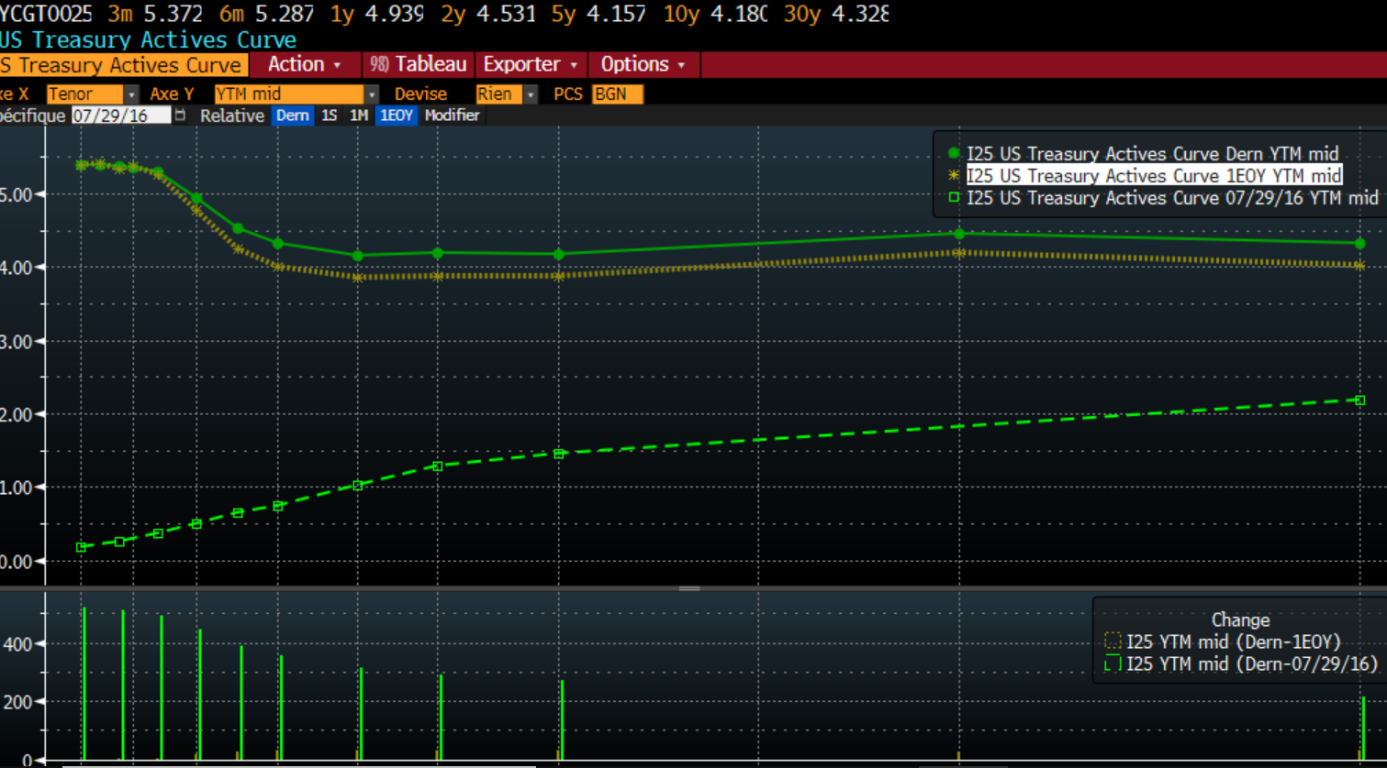
5.1 Non parallel shift

Slide 90
5.1 Non parallel shift
Principle:
Taking into account the yield curve changes for all maturities
Approaches
Bucket analysis
Key Rate Durations (Ho)
Shift and Twist factors (Scheinkman et Litterman)

Slide 91
5.1 Analysis of non-parallel shift of ZC yield curves
Bond

Slide 92
5.1 Analysis of non-parallel shift of ZC yield curves
Vector notation:
Duration vector:
convexity vector:

Slide 93
5.1 Analysis of non-parallel shift of YTM yield curves
Similar analysis if we consider a bond portfolio and use YTM
Portfolio
with

Slide 94
5.1 Analysis of non-parallel shift of YTM yield curves
Vector notation:
Vector notation:

Slide 95
5.2 Bucket analysis
Bucket analysis
Principle : breaking down the portfolio into sub portfolios
Each sub portfolio corresponds to a maturity range
Example : 2-5 yrs, 5-7 yrs…
We can make a parallel shift assumption for each sub portfolio !

Slide 96
5.2 Bucket analysis
Example
T modified durations based on portfolio weights and not sub portfolios weights
Portfolio Modified Duration = Sum of Sub Portfolios Modified Durations

Slide 97
5.2 Bucket analysis
The bucket analysis is simple and intuitive…
but the number of risk factors is high
Objective : finding other approaches with a limited set of factors

Slide 98
5.3 Key rate durations
Approach:
Bond price returns are a function of a limited set of factors.
Define key rates
Example: 2-year, 5-year, 10-year and 30-year
We postulate that each rate change is a function of key rates changes

Slide 99
5.3 Key rate durations
Bond return
Bond return is equal to
Example :

Slide 100
5.3 Key rate durations
S_{2ans}, S_{5ans}… are the key rate durations
The sum of key rate durations is equal to the standard modified duration
The interest rate risk of a portfolio is defined by its key rate durations

Slide 101
5.3 Key rate durations
Simple and easy to use
However, the risk factors are strongly corrrelated !

Slide 102
5.4 Shift and Twist Factors
Principal Components Analysis (PCA)
Objective: explain the behavior of yield curve changes using a smaller set of orthogonal factors
Principle: find common factors explaining interest rate changes
The factors are not specified but are implied…

Slide 103
5.4 Shift and Twist Factors
Historical data
for t = 1,2……T
Principe : transform a set of correlated variables into a reduced set of orthogonal variables that reproduces the original information present in the correlation structure

Slide 104
5.4 Shift and Twist Factors
We want to find principal components which can explain the maximum of the variance of interest rate changes
Objective:
Γ variance-covariance matrix of interest rate changes
We have to find the eigen values and the eigen factors of Γ

Slide 105
5.4 Shift and Twist Factors
The factors F_{i} are a linear combination of the data !!!
Each factor explains a fraction of the variance given by:
σ_{i} = interest rate i volatility

Slide 106
5.4 Shift and Twist Factors
Yield curve changes are a linear function of factor changes
We consider 2 factors F₁ and F₂ obtained thanks to PCA
F₁ et F₂ are common for all rates
α_{i} and β_{i} are given by PCA and can be different for each maturity
The first two factors explain between 90% and 95% of variance and are stable.

Slide 107
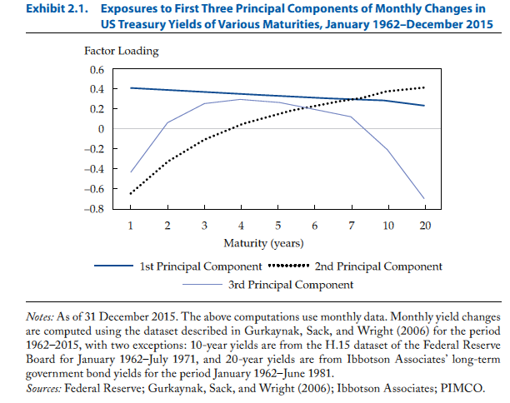
5.4 Risk factors : US market

Slide 108
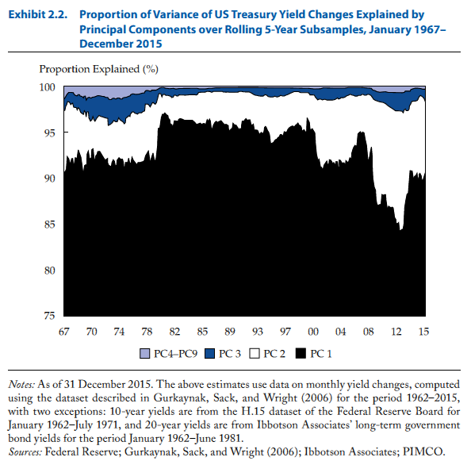
5.4 Risk factors : US market

Slide 109
5.4 Shift and Twist Factors
The first factor corresponds to a parallel shift of the yield curve :
The second factor corresponds to a twist of the yield curve
The shift and twist (level or slope) are driving yield curve dynamics
A third factor (butterfly or curvature) can be found in some markets but explain a limited fraction of interest rate changes.

Slide 110
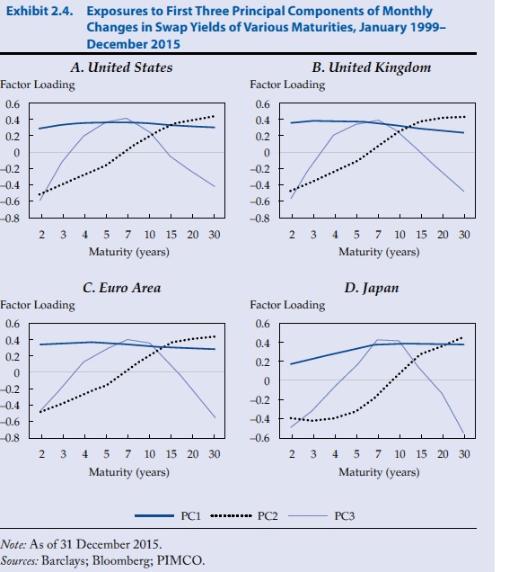
5.4 Risk factors : global evidence

Slide 111
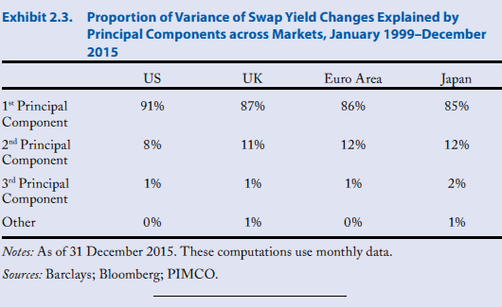
5.4 Risk factors : global evidence

Slide 112
5.4 How can we simply estimate the factors ?
The shift and twist factors can be approximated
Shift = Average changes in rates
Twist = Changes in the slope of the yield curve
Slope of the yield curve : 10 yr – 2yr

Slide 113
5.4 Shift and Twist Factors
General formula
is a function of F₁ and F₂.
If we neglect convexity terms:

Slide 114
5.4 Shift and Twist Factors
The return of a bond is a function of :
Its sensitivity to parallel shift
Its sensitivity to twist
A bond or a portfolio interest rate risks are defined by their shift and twist durations

Slide 115
5.4 Shift and Twist Factors
We have to go beyond duration which is based on an implicit assumption of a parallel shift of the yield curve.
We have to take into account non-parallel shifts
A portfolio interest rate risk is defined by its shift and twist durations

Slide 116
6. Fixed-Income strategies
6.1 Overview of strategies
6.2 Riding the yield curve
6.3 Forecasting Interest rate changes
6.4 Bond picking

Slide 117
6.1 FI strategies
Benchmark selection
Global / domestic
Hedged / Unhedged
Gvt / Aggregate
Country allocation
Overweighting / underweighting decisions based on the analysis of economic fundamentals (monetary policy, inflation, fiscal balance, political factors…)

Slide 118
6.1 FI strategies
Currency management
The volatility of currencies is much higher than for bonds
Separate the interest rate risk exposure and the currency exposure
Duration / Yield curve management
Duration : Market exposure
Yield curve : favour specific maturities

Slide 119
6.1 FI strategies
Sector selection / credit selection
Government
IG corporates
High Yield
Inflation Indexed
Bond selection
Generally limited impact due to strong correlation between bonds except for High Yield

Slide 120
6.1 FI strategies : Yield Curve strategies
Riding the Yield Curve
Forecasting Interest-rate changes

Slide 121
6.2 FI strategies : Riding the yield curve
Assumption : no changes in rates
Let’s consider at t a bond with maturity T and yield y(t,T)
What is the return between t and t+1 ?
The return is a function of y(t+1, T)-y(t,T)
If we assume no changes in rates, y(t+1, T)-y(t,T) = y(t,T-1) – y(t,T)
Investing in securities with maturities longer than the investment horizon and favouring maturities corresponding to the steepest slope of the yield curve
Empirical results : mixed results

Slide 122
6.3 FI strategies : forecasting interest-rate changes
Modelling the fair value of interest rates
The fair value is determined by economic fundamentals
Global bond markets are integrated and depend on US, Euro and JPY fundamental variables
Econometric approach
Modelling the Shift and twist factors

Slide 123
6.3 FI strategies : forecasting interest-rate changes
Modeling the country shift and twist factors
Shift
Twist
Real short-term rate
+
-
Inflation:
Short-term
Long-term
+
-
+
Economic activity
+
-
Unemployment rate
-
+
Fiscal balance
-
-
Current account
-
Global factors
+
+

Slide 124
6.4 FI strategies : Bond selection
Objective : to detect overpriced securities taking as a reference a theoretical zero-coupon yield curve
4 steps :
Construct a zero-coupon yield curve
Compute a theoretical price for each asset discounting cash flows with zero-coupon rates and derive a theoretical yield to maturity to be compared to the market rate (spread)
Z score analysis : Statistical analysis of any current mispricing to take into account specific factors (liquidity, taxes…)
Take long and short positions if justified

Slide 125
6.4 FI strategies : Bond selection
Z-score analysis : deciding if the current mispricing represents an opportunity by comparing it to historical values
2 approaches :
Historical distribution
Normal Distribution :
Compute the sample mean and standard deviation over the last 30,60,90 days
Ratio
Compare the ratio value with 2 and -2

Slide 126
6.4 FI strategies : Bond selection

Slide 127
7. Emerging markets
7.1 Overview
7.2 Hard Currency Debt
7.3 Local Currency Debt

Slide 128
7.1 EMD Asset Class
Notes:
128

Slide 129
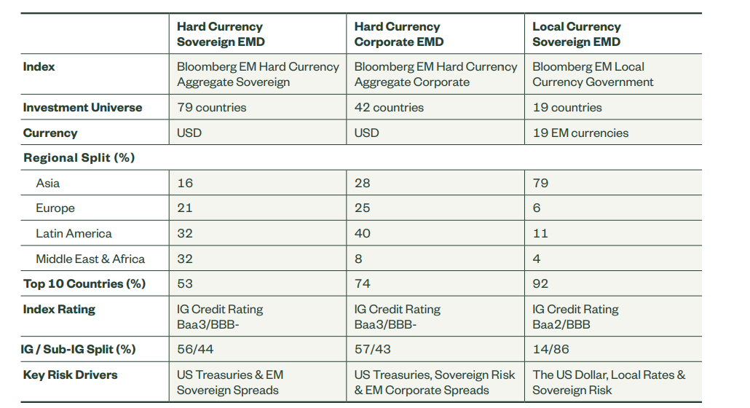
7.1 EMD Asset Class

Slide 130
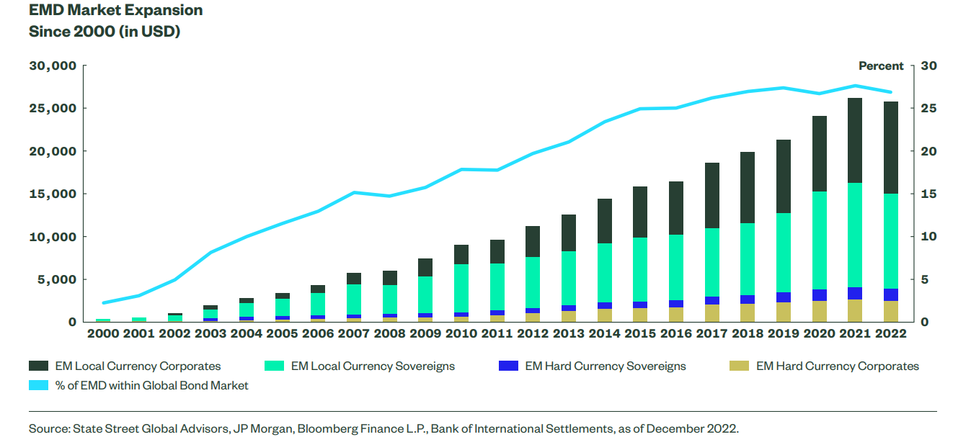
7.1 EMD Asset Class

Slide 131
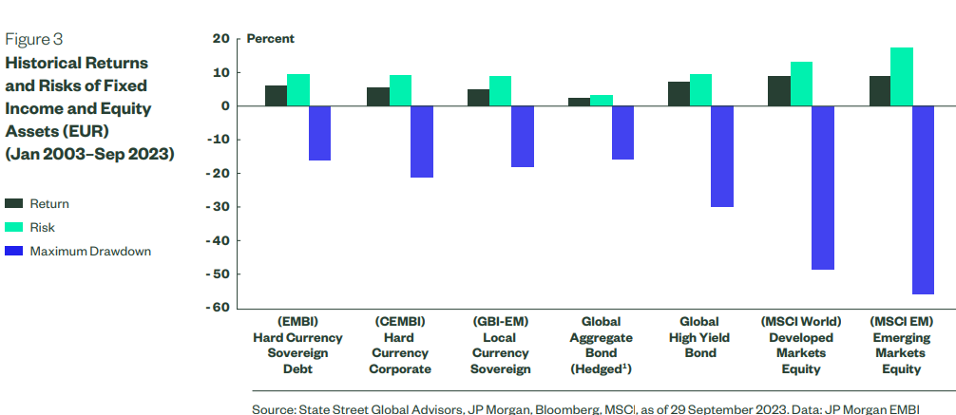
7.1 Asset class returns
Risk/return asset class profile over the past 20 years (in USD)
Risk/return asset class profile over the past 10 years

Slide 132
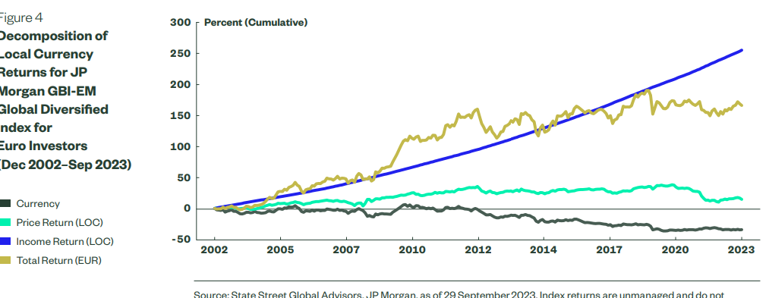
7.1 Asset class returns
Drivers of return for EMD Local Debt
Risk/return asset class profile over the past 10 years

Slide 133
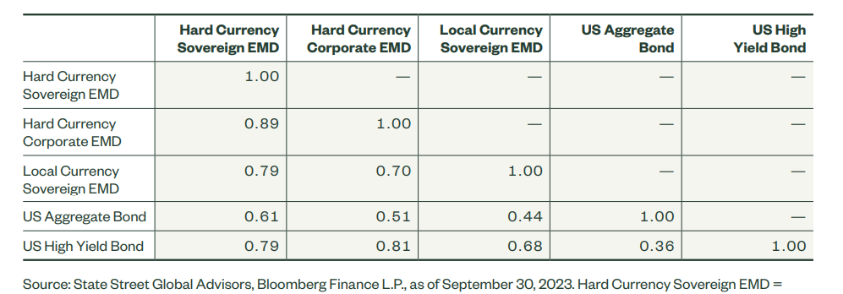
7.1 Asset class correlations
The US Treasury returns represent the JPM GBI US Country Index.
Source: JP Morgan. Data as of 30 September 2017. Correlations of month returns beginning January 2004. Past performance is no guarantee of future results. Indexes returns assume reinvestment of all distributions and not reflect fees or expenses. You cannot invest directly in an index. For index descriptions, please see disclosure at end of this presentation.

Slide 134
7.2 Hard Currency
EMBI Indices
JP Morgan indices
EMBI: comprised of Brady bonds and other similar sovereign restructured bonds (US dollar denominated)
EMBI+: includes USD denominated Brady bonds, Eurobonds, and traded loans issued by sovereign entities
EMBI Global: includes USD denominated Brady bonds, Eurobonds, and traded loans issued by sovereign and quasi-sovereign entities
EMBI Global Diversified
Mainly US dollar denominated issues
Notes:
134

Slide 135
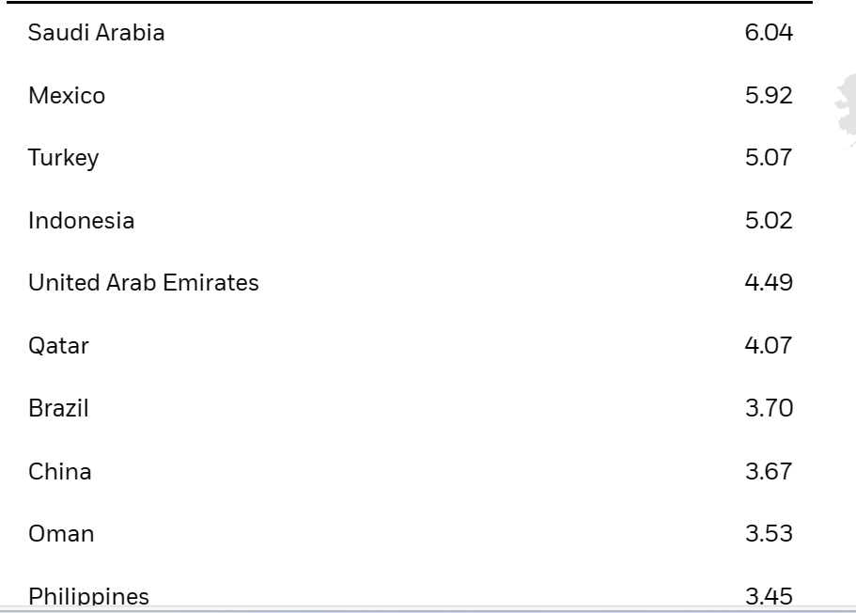
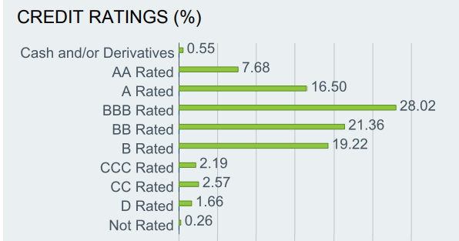
7.2 Hard Currency
EMBI Global composition
Notes:
135

Slide 136
7.2 Hard Currency
Valuation techniques
New risk source: issuer default risk or sovereign risk
Implying a spread vs. the US curve: sovereign spread
How to determine this spread?
Notes:
136

Slide 137
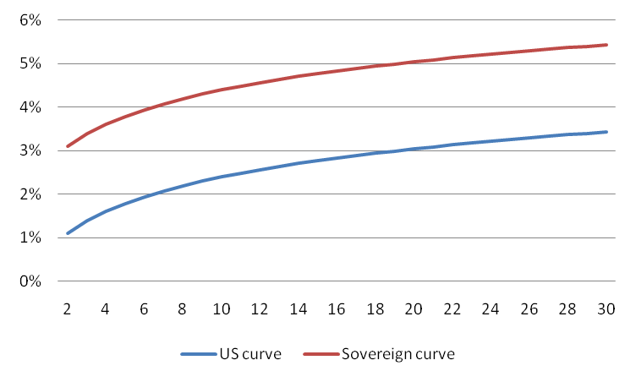
7.2 Hard Currency
Spread calculation
Sovereign spread: the premium for pure sovereign risk
For a given bond, the sovereign spread corresponds to a parallel shift of the US curve
Sovereign spread
Notes:
137

Slide 138
7.2 Hard Currency
Spread calculation: general case
Collateralized cash flows are discounted at the US rates
Uncollateralized cash flows are discounted at the sovereign rates
The forward US rates are used to take into account the rolling interest guarantees
Taking into account the optional features of some issues: Option-Adjusted Spread
Notes:
138

Slide 139
7.2 Hard Currency
Spread calculation: example
Considering a Brady bond with the following features:
Maturity 3 years with a yearly fixed coupon of 6%
The principal and the rolling one coupon are guaranteed
US curve: 1 year 5%; 2 years 6%; 3 years 7%
Price of 97$
The sovereign spread’s level?

Slide 140
7.2 Hard Currency
Spread calculation: example
The spread level OAS is given by :

Slide 141
7.2 Hard Currency
Risk measures
Two risk factors: sovereign spread and US rates 2 sensitivities:
Sensitivity to the sovereign spread: Spread Duration
Sensitivity to US rates: Int Duration
Very volatile spread: need to take into account convexity
Notes:
141

Slide 142
7.2 Hard Currency
Sovereign spread evaluation
The sovereign spread of an emerging country depends on:
Global variables:
Commodity prices
US inflation
US short rates
Risk aversion: US stocks volatility (VIX as a proxy)
….
Domestic variables:
Inflation
Short rates
Current account
External debt
….
Notes:
142

Slide 143
7.2 Hard Currency
How to invest in hard currency bonds
Hard currency bonds are mainly eurobonds:
International standardized documentation
Settlement through Euroclear or Clearstream
Good liquidity but decreasing
Bid ask spread of 5-7 bps (compared to 2-6 for euro corporate bonds)
Credit Default Swaps are another way to invest in the EM sovereign spreads
Good liquidity (Bid ask spread of 2-5 bps)
Notes:
143

Slide 144
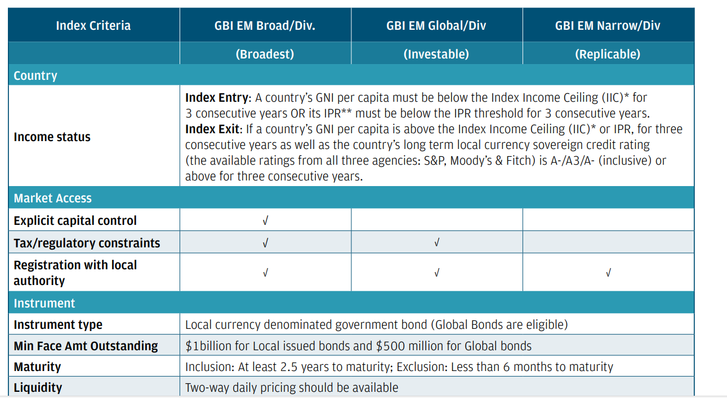
7.3 Local Currency Debt
Local currency indices
Source: Sinopia, JP Morgan.
Notes:
144

Slide 145
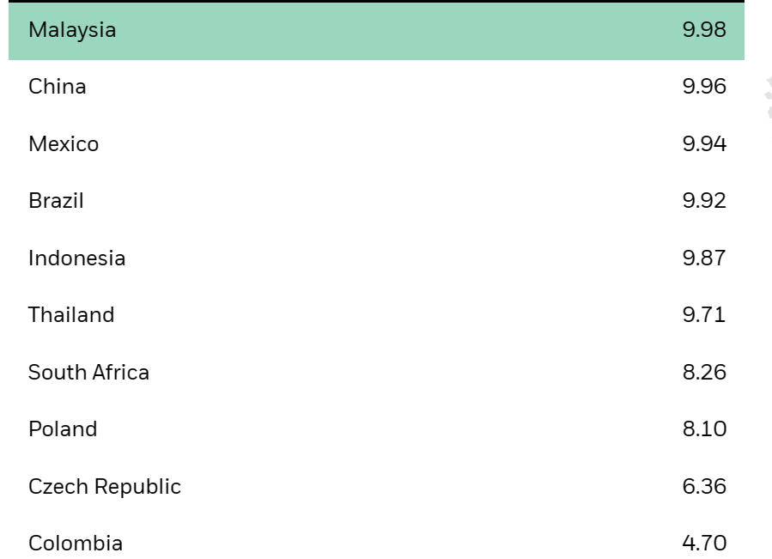
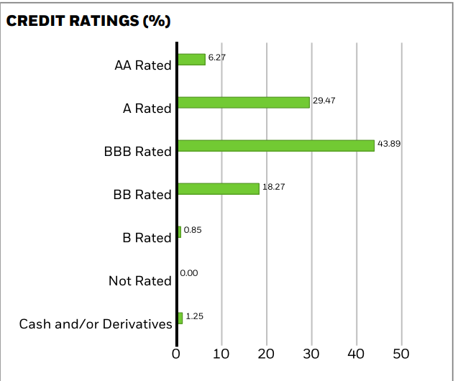
7.3 Local Currency Debt
JPM GBI-EM Global Constrained composition
Notes:
145

Slide 146
7.3 Local Currency Debt
How to invest in local currency bonds
The markets and their maturity are heterogeneous but almost all bonds are plain-vanilla
Specific constraints for many countries:
The currency is not convertible
Restrictive regulation (taxes, Central Bank registration , restrictions on capital flows …)
derivatives are not available in all markets (for hedging purpose
Notes:
146

Slide 147
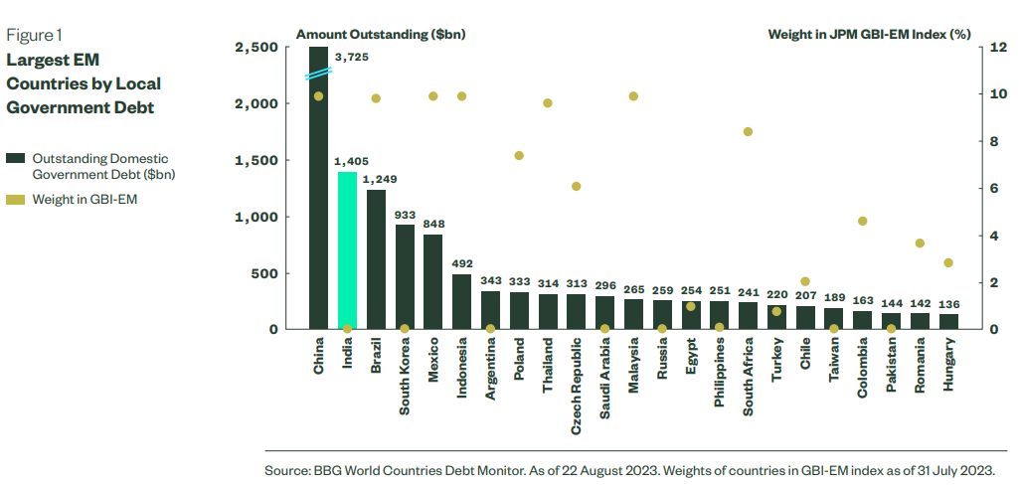
7.3 Local Currency Debt
How to invest in local currency bonds
Inclusion of India in the JPM GBI-EM Global Index in June 2024
Notes:
147

Slide 148
8. Corporate bonds and credit risk
8.1 Overview : definition, ratings and default rates
8.2 Credit spreads
8.3 Credit derivatives
8.4 Spread risk measures
8.5 Merton Model
8.6 Reduced-form models
8.7 Credit risk measures

Slide 149
8.1 Corporate Bonds
Broad definition : issued by Non Government companies
3 main types :
Covered Bonds
ABS
Corporate Bonds (Financial / industrial)
Strong heterogeneity :
Seniority
Sector
Rating

Slide 150
8.1 Seniority
Covered bonds / collateralized bonds
Senior bonds
Subordinated debt

Slide 151
8.1 Covered bonds
Debt securities backed by cash flows from mortgage loans or public sector loans
Main markets : Germany (Pfandbriefe), France (Obligations foncières), Spain (Cedulas)
Event default : double recourse to the issuer and the pool !

Slide 152
8.1 Asset-Backed Securities
SPV (Special Purpose Vehicle)
Underlying assets : mortage loans, consumer loans
Tranches : Senior (different ratings), Junior

Slide 153
8.1 Credit Risk
2 dimensions :
Default risk = not able to honor its obligations
Spread risk = risk of a downgrade of the ability to honor its obligations

Slide 154
8.1 Ratings
Credit rating : judgement on a company’s ability to honor its obligations

Slide 155
8.1 Default rates
Cumulative default rate by rating
Expected loss = Probability of Default * Severity of default
Expected Loss = Probability of Default * (1 - Recovery rate)

Slide 156
8.1 Annual Default rates
Annual Default rate = Conditional Default rates or Hazard rate
Annual Default rate in t+1 = Probability of default in t+1 knowing that there has been no default before

Slide 157
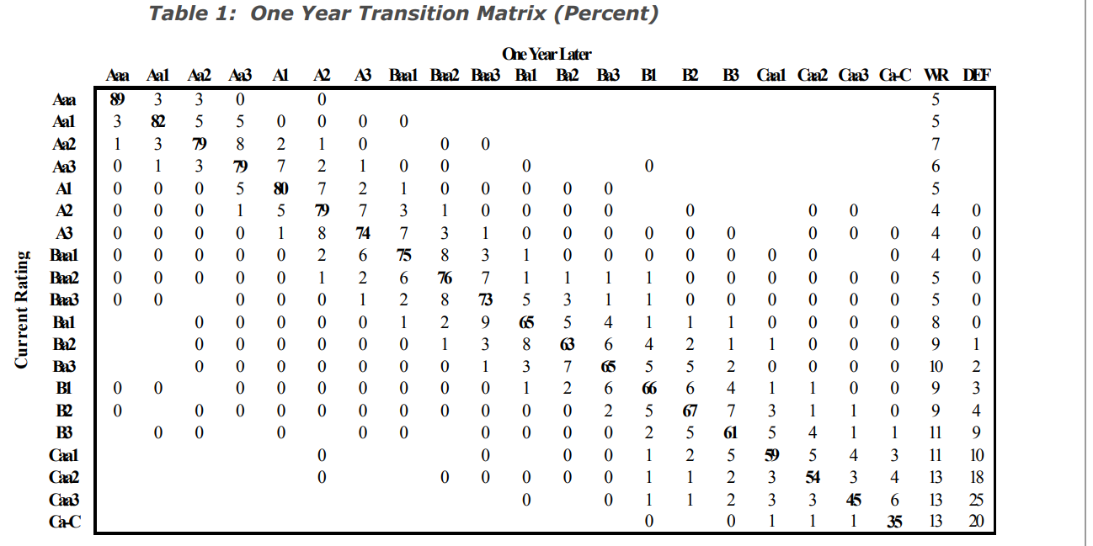
8.1 Transition matrix
Stability of transition matrix ?
Under the assumtion of stability of one-year transition matrix, the nth-year transition matrix M_{n} = M₁^{n}

Slide 158
8.2 Definition of credit spread
Different definitions for credit spread
Most often used definition = Bond yield spread
Bond Yield spread = YTM of a Corporate Bond – YTM of a Government Bond with same maturity
The credit spread is generally positive and volatile

Slide 159
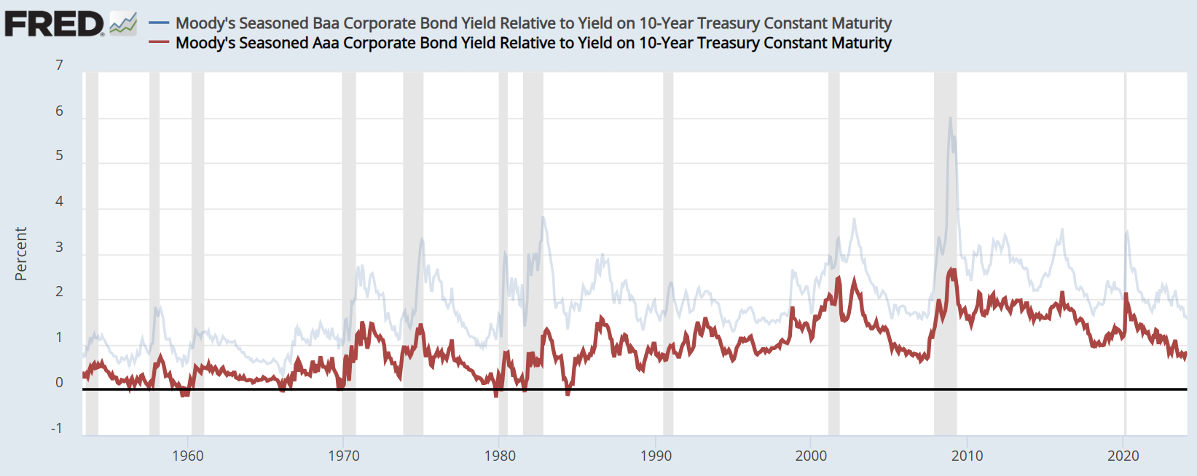
8.2 Historical Credit spreads

Slide 160
8.2 Components of credit spread
Expected loss
Compensation for default risk
Probability of default
Recovery rate 40%).
Credit risk premium (CRP)
Uncertainty about Default risk
Default risk not easily diversified
Systematic market risk like for equities
Liquidity premium
Practitioners usually consider that the credit spread is the credit risk premium. However, formally speaking, the credit risk premium is only a component of the credit spread

Slide 161
8.2 The Credit Spread Puzzle
CRP+liquidity premium
Expected Loss Component
Source : Explaining the rate spread on corporate bonds, Elton, Gruber, Agrawal and Mann, Journal of Finance 2001
Credit spreads are much wider than those implied by just expected default losses. This is the credit spread puzzle !

Slide 162
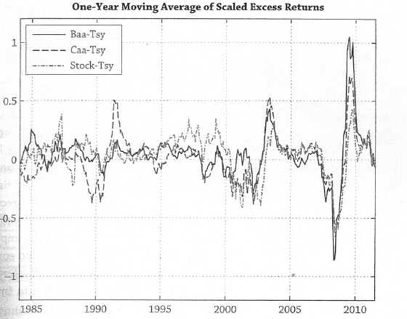
8.2 Components of credit spread
Source : Ang, Asset Management
Commonality of corporate bond returns and equity returns
Corporate bond investors are exposed to the same types of macro bad times risks as equity holders

Slide 163
8.2 Credit Spreads : other definitions
Z spread
Asset Swap Spread
CDS spread

Slide 164
8.2 Z spread
Using the zero-coupon yield curve to calculate spread
The zero-coupon curve used is derived from the interest-rate swap curve
y(0,i) corresponds to the zero-coupon swap rate with maturity i

Slide 165
8.2 Asset swap Spread
Asset swaps combine an interest-rate swap with a bond and are used to transform the fixed coupon of the bond into a Libor based floating coupon
The value of an asset swap is the spread paid over or under Libor

Slide 166
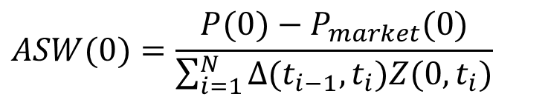
8.2 Asset swap Spread
The asset swap spread is given by
Z(0,t_{i}) is the Libor discount factor and Δ(t_{i-1},t_{i}) is the year fraction between successive paymenst for the floating leg of the asset swap
$$ASW(0)=\frac{P(0)−P_{market}(0)}{\sum_{i=1}^{N}{Δ(t_{i−1},t_{i})Z(0,t_{i})}}$$

Slide 167
8.3 Credit derivatives
Derivatives with a pay off depending on a credit event for a given entity
A protection buyer is going to pay a regular coupon (premium) to the protection seller who will compensate losses following credit event
A credit derivative enables to :
Separate market risk and credit risk

Slide 168
8.3 Credit Default Swap
Credit Default Swap (CDS)
Mechanism :
Principal + coupons – Recovery value
t
Premiums
X premium
Protection
buyer
Protection
seller
Payment if credit event

Slide 169
8.3 Credit events
Bankruptcy
Payment default

Slide 170
8.3 CDS 2.0
After the GFC, the CDS market has undergone substantial changes :
Big Bang and Small Bang Protocoles
Dodd-Frank Act
Physical settlement (standard)
The objective is to standardize CDS contracts to facilitate the reduction in notional outstanding and to reduce counterparty risk
Clearing and trading :
CDS contracts should be cleared by a Central Counterparty
CDS should be traded on an Exchange or on a Swap Execution Facility (SEF)
Changes were scheduled to take effect in 2011 but there were some delays…
Settlement :
ISDA Determination Committee decides whether there is an event for a specific CDS
Default settlement : in cash or by trading bonds (auction process)

Slide 171
8.3 CDS 2.0
Trading Format :
CDS trade with fixed coupons and upfronts
Coupons of 100bp and 500bp in the US / Coupons of 25, 50, 100, 500 and 1000 bp in EU
Four maturity dates per year : 20 of March, June, September and December
Why is there an upfront ?
Makes all contracts completely fungible
If spread is higher than coupon, then coupon is too small for actual risk. Therefore, we need to pay an upfront amount
Similar to bond trading at discount when yield higher than coupon
Example :
Assume 3 yr CDS market spread (par spread) is 180 bp
For a 100 bp contract, upfront is 2.3% :
2.3% is the present value of the 80 bp we are not paying each year on our 100 bp protection

Slide 172
8.3 CDS Indexes
Indice
Composition
Universe
Commentaires
iTraxx Main Europe
125 CDS
Investment grade Euro
Predetermined sector allocation
iTraxx HiVol
30 CDS
20 non financial CDS with the highest spread
iTraxx X-Over
50 CDS
High Yield Euro
CDX IG
125 CDS
Investment grade US
CDX EM
14 CDS
Emerging markets
Rebalancing every 6 months : 20 september and 20 march
Equally weighted
Several maturities ( 3, 5, and 10 years)

Slide 173
8.4 Spread risk measures
Spread duration
Duration Times Spread

Slide 174
8.4 Spread duration
Usually measured with respect to changes in Z-spread
For a plain-vanilla bond, spread duration corresponds to Modified Duration
2 components for a corporate bond return :
Changes in interest rates : –Mod D * Δr
Changes in spread : – Spread Duration*Δs

Slide 175
8.4 Duration Times Spread (DTS)
A new measure of spread exposure in credit portfolios
Volatility of the spread component : Spread Duration * σ (Δs).
The usual approach to forecast credit volatility is to use the historical volatility of changes in spreads. However, spread volatility is not stable.

Slide 176
8.4 Duration Times Spread (DTS)
DTS definition
Spread Duration * Δs = Spread Duration *s * (Δs/s)
DTS = Spread Duration *s
Credit volatility = DTS * σ (Δs/s)
The volatility of relative changes in spreads is much more stable as the volatility of spread changes is linearly proportional to spread level

Slide 177
8.4 Duration Times Spread (DTS)

Slide 178
8.4 Duration Times Spread (DTS)

Slide 179
8.5 Valuation of corporate bonds
Traditional approach based on financial analysis :
Analysis of balance sheet and income statements
Calculation of ratios
Quantitative analysis

Slide 180
8.5 Quantitative analysis
Structural models :
Default time is predictable.
A corporate bond is regarded as a contingent contract written on the firm value
Default corresponds to the firm value being lower than a given threshold
Example : Merton model
Reduced form models or intensity based models
Default time is unpredictable
Equivalent to no-arbitrage term structure models
Credit risk is defined by 2 parameters : probability of default and recovery rate
Example : Fons model and Jarrow Turnbull model

Slide 181
8.5 Merton model : principles
Equities and bonds can be interpreted as options on the firm value
Use Market values and not book values
Modigliani Miller : the firm market value is equal to the sum of debt and equity
V_{t} = E_{t} + D_{t}

Slide 182
8.5 Merton model : assumptions
The firm market value V_{t} is driven by :
σ is business risk
Debt : Zero-coupon with nominal B and maturity T
Default can only occur at T
Constant risk free rate

Slide 183
8.5 Merton model
Firm residual value
default
Flows
at maturity
solvency
Debt Nominal value
Debt investor

Slide 184
8.5 Merton model
Nothing…
default
Flows
at maturity
solvency
Firm value – Nominal Debt value
Equity investor

Slide 185
8.5 Debt as an option
At maturity, equity value is equal to
E_{T} = max (0, V_{T} – B)
E_{t} is the value of a call option. The underlying is the firm value, the strike is equal to B and maturity to T

Slide 186
8.5 Debt and Equity as options

Slide 187
8.5 Debt value
E_{t} can be calculated by using Black-Scholes formula
E_{t} = V_{t} N(d₁) - B e^{-r (T-t)} N(d₂)
We can derive the value of D_{t}
D_{t} = V_{t} – E_{t}
D_{t} = f(V_{t}, σ, B, r, T)

Slide 188
8.5 Spread calculation
YTM is defined by :
D_{t} = B e^{-y(t,T) (T-t)}
y(t,T) - r = 1/(T-t) ln (B/D_{t}) - r
The spread is a function of leverage and volatility

Slide 189
8.5 Implementation of Merton model
Objective : calculate a fair value spread and compare it to market spread
Based on balance sheet analysis, we can estimate B and T values
2 unknown variables : V and σ

Slide 190
8.5 Implementation of Merton model
V and σ are derived from equities markets
E_{t} is equal to equity market value
Relationship between σ and equity volatility
We have 2 equations with 2 unknown variables
V and σ are derived by inversion of Black Scholes formula

Slide 191
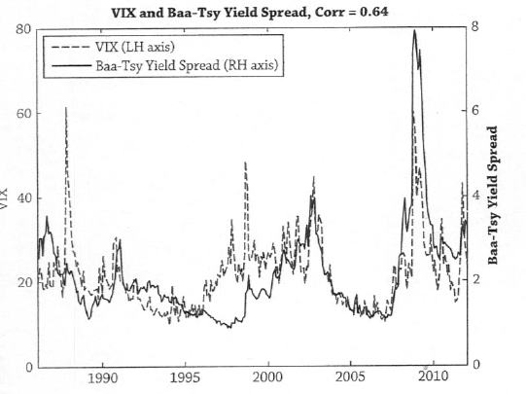
8.5 Merton model : empirical relationship between credit spreads and volatility
Source : Ang, Asset management
Credit investments are short volatility trades !

Slide 192
8.5 Merton model : Enron
Ratings S&P :
08/12/95 : BBB+
01/11/01 : BBB
09/11/01 : BBB-
28/11/01 : B-
30/11/01 : CC
03/12/01 : D

Slide 193
8.5 Merton model : conclusion
Enhancements of the Merton approach : stochastic interest rate, default before maturity…
Very satisfactory from a theoretical perspective as we understand default which does not come as a surprise
However, in practise, bond prices generally jump down on news of impending default. Besides, empirical analysis shows that structural models significantly underestimate the probability of default over short periods.
Is default unpredictable ?

Slide 194
8.6 Reduced form models : Fons approach
It relates ratings with bond prices
Investors are risk neutral. The value of the risky bond is equal to its certain equivalent expressed as the expected value of cash flows discounted at the risk-less interest rate
The expected value of each cash flow is expressed as the sum of the cash flow received if the firm does not default weighted by the probability of survival and the cash flow received in the event of default weighted by the probability of default

Slide 195
8.6 Reduced form models : Fons approach
We calculate the theoritical price of a risky bond for a risk neutral investor
D_{t} = Conditional probability of default in year t
S_{t} = probability of survival at date t
μ = recovery rate
y(0,i) = riskless interest rate

Slide 196
8.6 Reduced form models : Fons approach
We use historical default rates and recovery rates to calculate the theoritical price and theoritical YTM
We can estimate a maximum and minimum value for the theoritical YTM by making extreme assumptions about the recovery rate : 0% and 60%

Slide 197
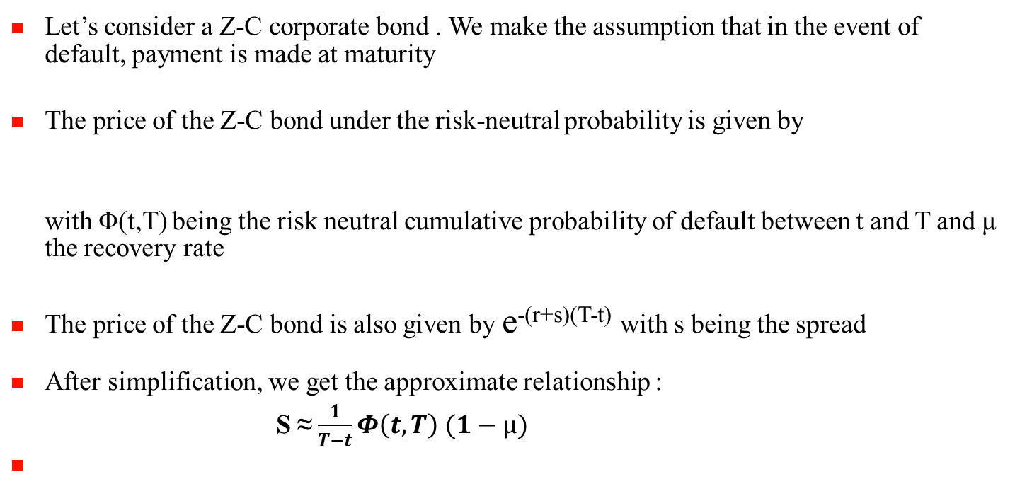
8.6 Reduced Form models : Risk neutral probability of default and spread

Slide 198
8.6 Reduced Form models : stripping of Risk neutral probabilities
Objective : estimate the market implied probability of default based on current market spreads
This relationship does not rely on any specific model

Slide 199
8.6 Jarrow Turnbull model
Jarrow and Turnbull (1995) : the benchmark approach for CDS pricing
Modelling probability of default
A credit event is the first occurrence of a Poisson distribution at date with probability :
is the « Hazard Rate » or default intensity
Survival with probability
Default with probability

Slide 200
8.6 Jarrow Turnbull model
Over n periods
if , survival probability can be written as

Slide 201
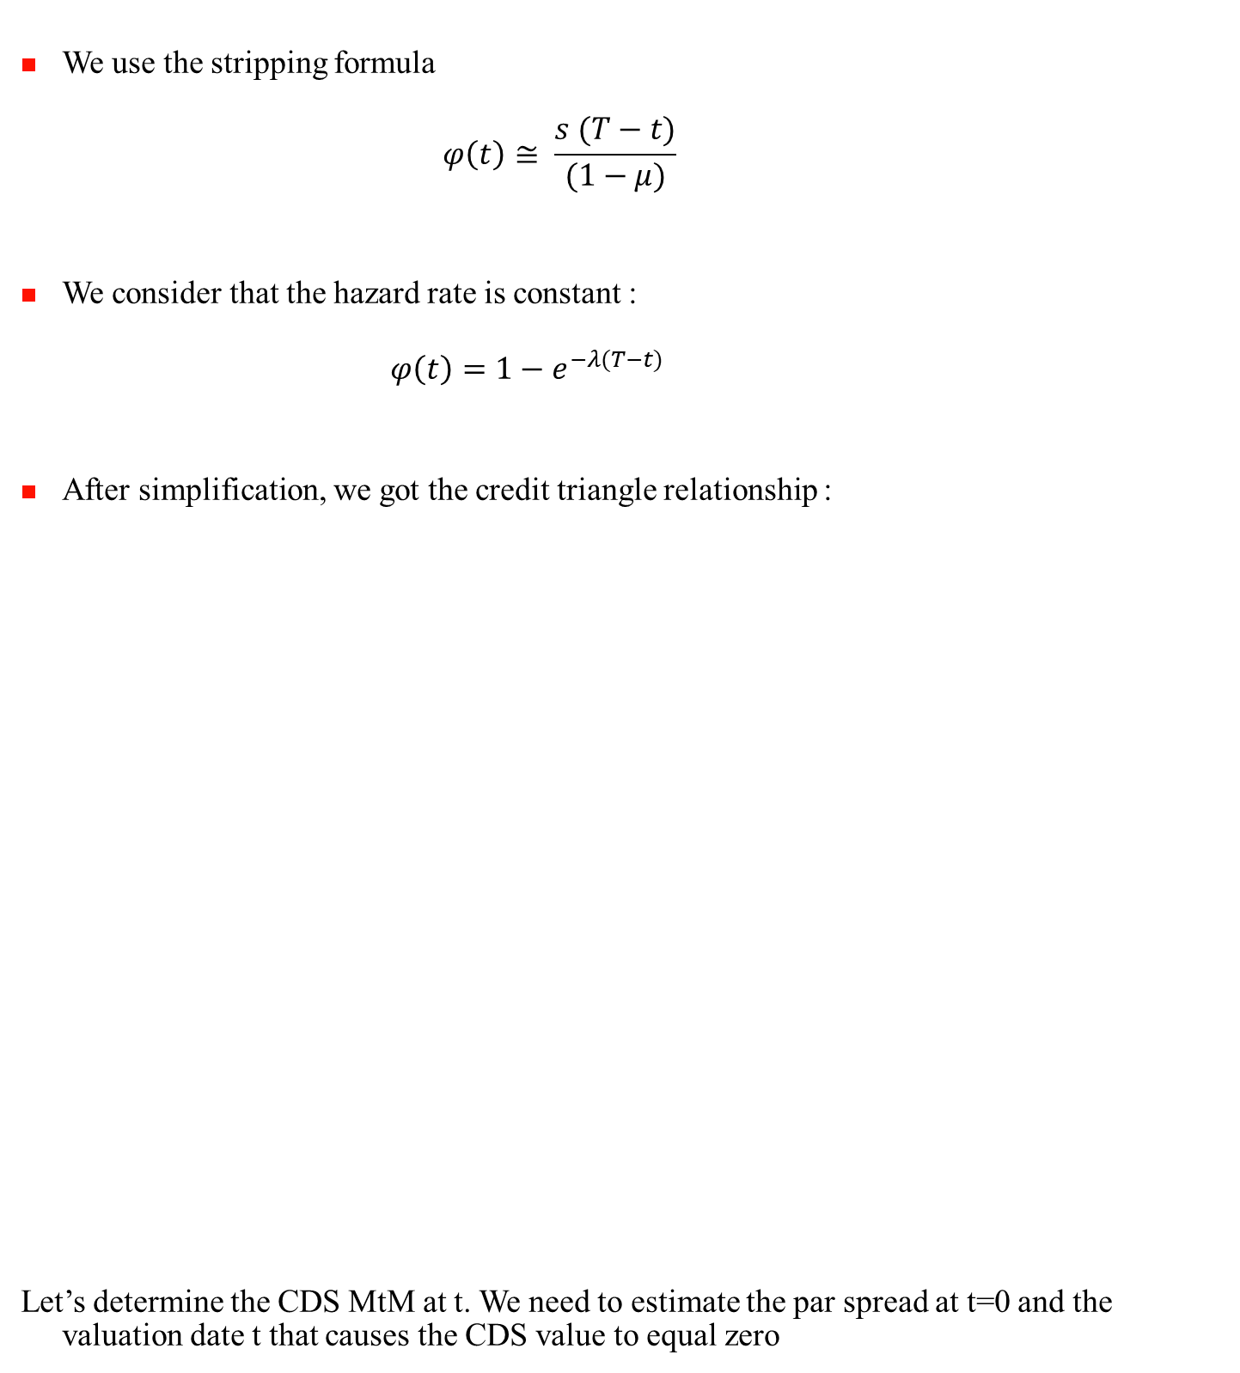
8.6 Jarrow Turnbull model : credit triangle relationship
We use the stripping formula
$$φ\left(t\right)≅ \frac{s (T−t)}{(1−μ)}$$
We consider that the hazard rate is constant :
$$φ\left(t\right)=1−e^{−λ(T−t)}$$
After simplification, we got the credit triangle relationship :
Let’s determine the CDS MtM at t. We need to estimate the par spread at t=0 and the valuation date t that causes the CDS value to equal zero

Slide 202
8.6 CDS pricing
a CDS is a swap and we need to value the floating leg and the fixed leg
At t=0 we enter into a CDS and agree to pay C and upfront for protection
How to determine the CDS MtM at t ?
We need to estimate the par spread at t=0 and at the valuation date t.
The par spread causes the CDS value to equal zero : there is no upfront payment !
Let’s determine the CDS MtM at t. We need to estimate the par spread at t=0 and the valuation date t that causes the CDS value to equal zero

Slide 203
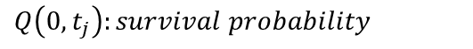
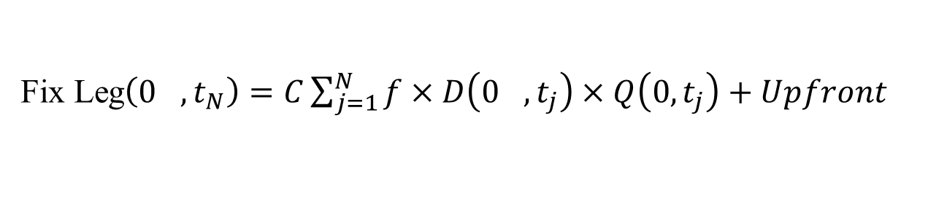
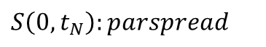
8.6 CDS pricing
At t=0 we enter into a CDS and pay C for protection
Fixed leg : Premium payment until maturity (t_{N}) or default event
With
Fix Leg$\left(0_{},t_{N}\right)=C\sum_{j=1}^{N}{f×D\left(0_{},t_{j}\right)×Q\left(0,t_{j}\right)}+Upfront$
Fix Leg$\left(0_{},t_{N}\right)=S\left(0,t_{N}\right) \sum_{j=1}^{N}{f×D\left(0_{},t_{j}\right)×Q\left(0,t_{j}\right)}$
$$S\left(0,t_{N}\right):parspread$$
$$f:fraction ofyearbetween 2 payments$$
$Q\left(0,t_{j}\right):survival probability$
Notes:
203

Slide 204
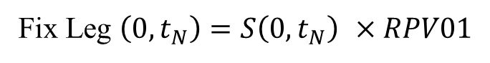
8.6 CDS pricing
Let’s define Risky PV01, the fixed leg present value for 1 bp premium
Fix Leg $\left(0,t_{N}\right)=S\left(0,t_{N}\right) ×RPV01$
Notes:
204

Slide 205
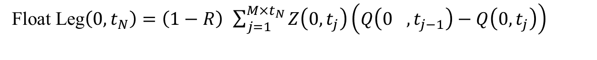
8.6 CDS pricing
Floating leg
Payment of (1-R) in the case of a credit event
In discrete time :
Recovery rate is assumed to be 40%
Float Leg$\left(0,t_{N}\right)=\left(1−R\right) \int_{0}^{t_{N}}{D\left(0_{},s\right)Q\left(0_{},s\right)λ\left(s\right)ds}$
Float Leg$\left(0,t_{N}\right)=\left(1−R\right) \sum_{j=1}^{M×t_{N}}{Z\left(0,t_{j}\right)\left(Q\left(0_{},t_{j−1}\right)−Q\left(0,t_{j}\right)\right)}$
Notes:
205

Slide 206
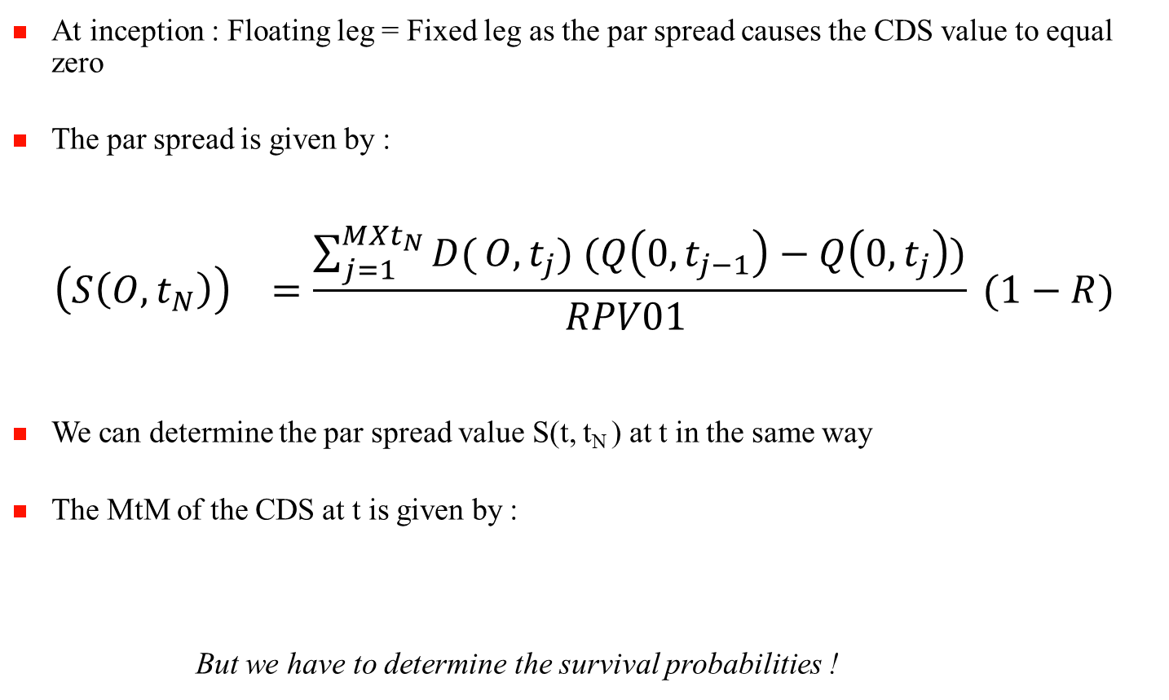
8.6 CDS Pricing
At inception : Floating leg = Fixed leg as the par spread causes the CDS value to equal zero
The par spread is given by :
$${\left(S\left(O,t_{N}\right)\right)}^{}=\frac{\sum_{j=1}^{MXt_{N}}{D(}O,t_{j}) (Q\left(0,t_{j−1}\right)−Q\left(0,t_{j}\right))}{{RPV01}_{}} (1−R)$$
We can determine the par spread value S(t, t_{N} ) at t in the same way
The MtM of the CDS at t is given by :
But we have to determine the survival probabilities !
Notes:
206

Slide 207
8.6 CDS pricing : how to estimate the survival probabilities ?
The survival probabilities are implied from CDS market prices
We have to prespecify a form of the survival proabilities : Hazard rate function
Similar to the Vasicek-Fong methodology for estimating zero-coupon yield curve
The standard assumption is to assume that the hazard rate is a piecewise flat function of time

Slide 208
8.6 CDS pricing : building a hazard rate term structure
The survival probability is modelled by

Slide 209
8.6 Historical versus RN probability of default
The RN probability of default is given by
The RN probabilities of default are consistently and significantly higher than actual probabilities of default

Slide 210
8.6 Historical versus RN probability of default
Liquidity premium
The default probabilities extracted from bond prices are risk neutral probabilities while default probabilities estimated from historical data are real world default probabilities

Slide 211
8.6 Historical versus RN probability of default
Merton’s approach
Probability of default : p_{t,T} = P (V_{T} < B)
P _{t,T} is given by

Slide 212
8.6 Historical versus RN probability of default
The formula for the risk neutral probability is similar except that the drift is replaced by the riskfree rate
Using CAPM
We obtain the following formula for the risk neutral probability of default q_{t,T}

Slide 213
8.6 Historical versus RN probability of default
When ρ >0, the risk neutral probability is higher than the real world probability.
Interpretation :
Default risk is priced as it is not diversifiable !
The probability of default increases when the value of firm assest decreases which also happens when the value of market portfolio decreases.

Slide 214
8.7 Risk of a corporate bond
2 sources of risk
Interest rates
Credit (spread)
The distribution of a corporate bond is not gaussian and has fat tails due to credit risk
Merton ‘s model : Corprate Bond = Risk Less Bond – Sale of Put option

Slide 215
8.7 Risk of a credit portfolio
Frequency
30%
360 bonds
30 bonds
20%
10 bonds
10%
0%
Return
(1-year horizon)
-4%
-2%
0%
2%
4%
The distribution of a credit risk portfolio is not gaussian and has fat tails
A credit portfolio does not benefit from the Central Limit Theorem
Defaults are correlated !

Slide 216
8.7 How to estimate credit risk ?
Volatility is not a good risk measure for credit risk. Need to use other risk measures : Credit VaR
2 potential approaches :
MtM : market values of corporate bonds at H are estimated
Default Mode : we consider only losses due to default

Slide 217
8.7 Credit VaR of a corporate bond
MKMV approach based on Merton’s model.
Default at H corresponds to firm value being lower than a given threshold V_{d} and H=1 year
V_{d} = ST Debt +1/2 Lt Debt. It is based on the fact that empirically there is a high probability of default when the firm value is between ST debt and LT debt
Definition of Distance to Default (DD)
There is default at H if V_{H} <V_{d}
P(V_{h} <V_{d}) = P (W_{H}<-DD) = N(-DD)

Slide 218
8.7 Credit VaR of a corporate bond
MKMV does not use N(-DD) as the probability of default but the expected default frequency (EDF)
The expected default frequency (EDF) is defined by EDF = f(DD)
f is defined to fit historical default frequencies and DD

Slide 219
8.7 Credit VaR of a credit portfolio
No closed formulas except under strong assumptions
Monte Carlo simulations and the potential use of copulas functions to build the whole distribution and estimate Credit VaR

Slide 220
9. Inflation Linked Bonds
9.1 Real assets
9.2 ILBs mechanisms
9.3 ILBs markets
9.4 ILBs in a bond portfolio
9.5 ILB evaluation

Slide 221
9.1 Real return assets and protection from inflation: Strong case for inflation-linked bonds
Correlations between asset total returns and headline US CPI (UK RPI for UK bonds) since 1987, under different holding periods
Commodities and short-dated inflation-linked bonds are significantly correlated with inflation
Inflation protection depends on the holding period
* NCREIF US National Property Index, which contains the NCREIF Residential, Apartment, Industrial, Office, Retail and Hotel Property Indices. Source: NCREIF, Ecowin, Barclays Capital

Slide 222
9.1 Real return assets and protection from inflation: Strong case for inflation-linked bonds
A real asset allocation should always include inflation-linked bonds as they provide the most efficient hedge against inflation over the long term
A real asset allocation should always include inflation-linked bonds as they provide the most efficient hedge against inflation over the long term
 | Risk* | Liquidity | Inflation Hedge
Global inflation-linked bonds | Low | High | High
Commodities | High | Moderate to high | Moderate to high
Real estate - Public REITs | High | Moderate to High | Slight to moderate
Global equity | High | High | Slight to moderate

Slide 223
9.2 What is an inflation-linked bond?
A simple structure indexed on inflation
The principal is not constant and indexed on inflation
LH scale: Yr1 - 9
RH scale: Yr10
20
10-yr OATi 2.5% Cash flows assuming a 2% annual inflation
102.5x(1+2%)¹⁰
120
80
10
2.5x(1+2%)³
40
2.5x(1+2%)
2.5x(1+2%)²
…
0
0
1
2
3
4
5
6
7
8
9
10

Slide 224
9.2 ILB characteristics : OATi example
A simple structure:
A Variable nominal, daily indexed INSEE ex tobacco CPI. Par floor value at maturity.
A fixed coupon rate
Indexation mechanism
Linear interpolation between last indexes
Released Inflation
Indexation
31/03/03
30/04/03
31/05/03
30/06/03
30/07/03
30/08/03

Slide 225
9.2 What is an inflation-linked bond?
Pricing
T
C
100
The price of a nominal bond is given by
Where NR: nominal rate
The price of an ILB is given by
Where:
I_{t}: current inflation index value
I₀: inflation index level at issue date
RR: real rate
Similar pricing formulas with two exceptions:
indexation ratio
real cash flows are discounted at real rates and not nominal rates
P
=
∑
+
t
(
)
i
(
)
=
1
+
NR
1
+
NR
T
i
t
I
⎡
T
C
100
⎤
P
=
t
⎢
∑
+
⎥
t
(
+
)
i
(
+
)
T
I
⎣
i
=
t
1
RR
1
RR
⎦
0

Slide 226
9.2 What is an inflation-linked bond?
Return
The return of an ILB can be broken down into 3 components :
- Carry / Passage of time
- Cash Flow Growth
- Valuation Change
The carry return is Real Rate (t) * dt
The Cash Flow Growth is I_{t+1} / I_{t} - 1
The valuation change is given by : – Mod Duration * Real Rate Change

Slide 227
9.3 A mature and rapidly growing asset class
Capitalisation of the principal indexed government bond markets
USD 2,827 bn in the developed inflation-linked bond market, USD 3,370 bn in total
Market size has risen significantly in the past fifteen years, both in developed and emerging countries
Source: Bloomberg Barclays. Data as at 31 July 2017.

Slide 228
9.3 Overview of main developed market inflation-linked bond issuers
Reasons for issuing inflation-linked bonds:
Matching state liabilities effectively
Debt servicing in line with economic cycles
Credibility of governments to anchor inflation expectations
Diversification of investor base
 | UK | Australia | Canada | Sweden | US | Eurozone | Japan | New Zealand | Denmark
First issue | 1981 | 1985 | 1991 | 1994 | 1997 | 1998 | 2004 | 1995 | 2012
Principal guarantee | No | Yes | No | Since 04/99 | Yes | Yes | No | Yes | Yes
Number of gov’t securities | 27 | 8 | 8 | 8 | 38 | 36 | 6 | 4 | 1
Market size in EUR billion | 840.0 | 35.7 | 59.0 | 30.4 | 1253.8 | 586 | 67.7 | 12.7 | 6.7
% of total debt of the country | 35% | 9% | 16% | 26% | 12% | 8% | 1% | 10% | 5%
Source: Bloomberg Barclays – Data as at 30 August 2017. Only for new issues.

Slide 229
9.4 Importance of ILBs in asset allocation
Less risky, less volatile and weakly correlated assets
Inflation-linked bonds are less risky than nominal bonds as they provide a protection against inflation
Inflation-linked bonds are relatively weakly correlated with other assets (less than 50%) over the long term, especially with nominal bonds
The volatility of an inflation-linked bond is estimated to be two-thirds that of a nominal bond

Slide 230
9.4 Importance of ILBs in asset allocation
Benefits from an institutional investor’s perspective
Including ILBs in an allocation:
provides an effective hedge against inflation
diversifies a global portfolio over the medium/long term
reduces the risk in the fixed income portion
cushions the negative impact of rising yields in bond markets
According to the investment objectives, a varying amount of ILBs should be included in the allocation:
20% to 30% to optimise the risk/return profile
above 70% to hedge long-term commitments (asset & liability management)
Choice of the underlying universe according to the investor’s needs:
hedge against inflation
bond portfolio diversification: asset class or geographical diversification
access to an « exotic » asset class: Emerging ILBs

Slide 231
9.5 Inflation-Linked Bonds: valuation
Fisher equation
Real rate (*)
Return on Savings
+
Nominal rate (*) =
Expected inflation
Preservation of purchasing power
+
Breakeven
inflation rate
Inflation risk premium
Uncertainty about expected inflation
Real rate (*) = Nominal rate (*) – Breakeven inflation rate
(*) Market variables

Slide 232
9.5 Inflation-Linked Bonds: valuation
Breakeven Inflation
BEI = Nominal rate – real rate
BEI is the future inflation rate required for an ILB to achieve the same return as a nominal bond if held to maturity
BEI is a rough measure of inflation expectations
inflation risk premium
liquidity premium
%
%
5.0
Real rates
3.0
Nominal rates
BEI
4.0
3.0
2.0
BEI
2.0
1.0
1.0
0.0
0.0
2Y
5Y
7Y
10Y
20Y
2Y
5Y
7Y
10Y
20Y
Sources: Bloomberg – Données au 29/08/08 * BEI (Breakeven Inflation) : Inflation point mort.

Slide 233
9.5 Inflation-Linked Bonds: valuation
Framework for modeling BEIs
Objective: calculate the fair value of BEI for each market and each maturity
BEIs depend on domestic and global variables
Global variables depend on US, Euro zone and Japanese variables
Shift
Twist
Observed inflation
(domestic and global)
+
-
1-year expected change in
inflation (domestic and global)
+
+
Long term expected inflation (domestic and global)
+
+
Economic growth (domestic and global)
+
-
Oil price change
+
-
US gasoline price change
+
-

Slide 234
9.5 Inflation-Linked Bonds: valuation
What drives changes in the equilibrium BEI?
Impact of 1% increase in long-term expected domestic inflation (%)
Impact of 1% increase in observed domestic inflation
and 1-year expected change in domestic inflation (bp)
40
Observed domestic inflation
30
20
1-year expected change in domestic inflation
10
0
2
3
5
7
10
15
20
30
Impact of 10% increase in Oil Price and US Gasoline Price (bp)
Impact of 1% increase in global economic growth (bp)
25
United States
40
Australia
20
France
30
Sweden
United Kingdom
15
Japan
Euro zone
20
10
5
10
0
2
3
5
7
10
15
20
30
0
2
3
5
7
10
15
20
30

